Slide 1

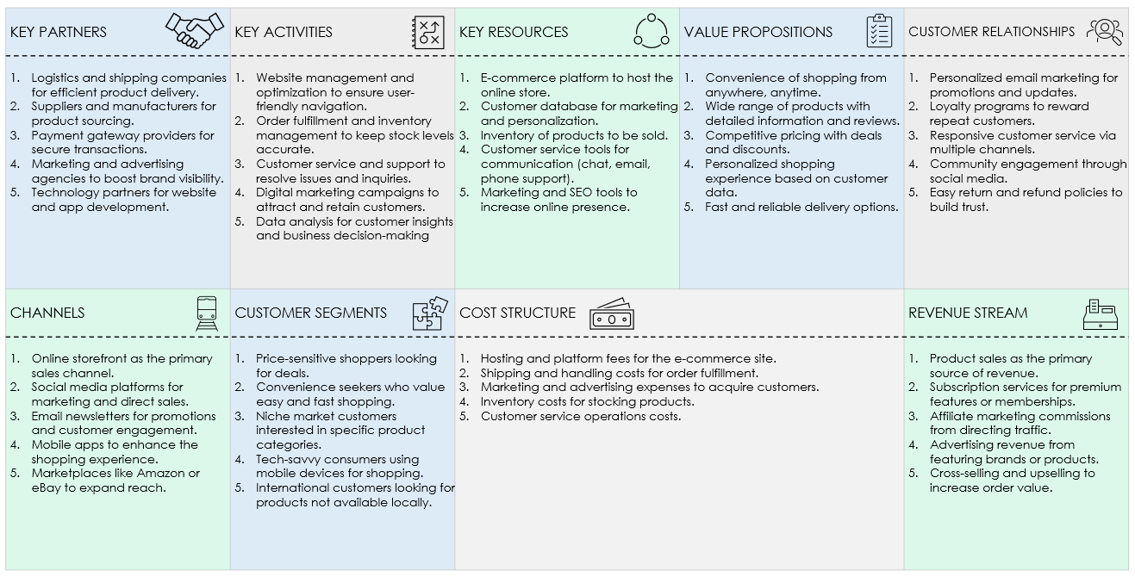
E-COMMERCE BUSINESS MODEL CANVAS TEMPLATE EXAMPLE for PowerPoint
The following slide provides a comprehensive overview of an e-commerce business model, highlighting key considerations for each section.

Slide 2









E-COMMERCE BUSINESS MODEL CANVAS TEMPLATE EXAMPLE
KEY PARTNERS | KEY ACTIVITIES | KEY RESOURCES | VALUE PROPOSITIONS | CUSTOMER RELATIONSHIPS
Logistics and shipping companies for efficient product delivery. Suppliers and manufacturers for product sourcing. Payment gateway providers for secure transactions. Marketing and advertising agencies to boost brand visibility. Technology partners for website and app development. | Website management and optimization to ensure user-friendly navigation. Order fulfillment and inventory management to keep stock levels accurate. Customer service and support to resolve issues and inquiries. Digital marketing campaigns to attract and retain customers. Data analysis for customer insights and business decision-making | E-commerce platform to host the online store. Customer database for marketing and personalization. Inventory of products to be sold. Customer service tools for communication (chat, email, phone support). Marketing and SEO tools to increase online presence. | Convenience of shopping from anywhere, anytime. Wide range of products with detailed information and reviews. Competitive pricing with deals and discounts. Personalized shopping experience based on customer data. Fast and reliable delivery options. | Personalized email marketing for promotions and updates. Loyalty programs to reward repeat customers. Responsive customer service via multiple channels. Community engagement through social media. Easy return and refund policies to build trust.
CHANNELS | CUSTOMER SEGMENTS | COST STRUCTURE |  | REVENUE STREAM
Online storefront as the primary sales channel. Social media platforms for marketing and direct sales. Email newsletters for promotions and customer engagement. Mobile apps to enhance the shopping experience. Marketplaces like Amazon or eBay to expand reach. | Price-sensitive shoppers looking for deals. Convenience seekers who value easy and fast shopping. Niche market customers interested in specific product categories. Tech-savvy consumers using mobile devices for shopping. International customers looking for products not available locally. | Hosting and platform fees for the e-commerce site. Shipping and handling costs for order fulfillment. Marketing and advertising expenses to acquire customers. Inventory costs for stocking products. Customer service operations costs. |  | Product sales as the primary source of revenue. Subscription services for premium features or memberships. Affiliate marketing commissions from directing traffic. Advertising revenue from featuring brands or products. Cross-selling and upselling to increase order value.

Slide 3
DISCLAIMER Any articles, templates, or information provided by Smartsheet on the website are for reference only. While we strive to keep the information up to date and correct, we make no representations or warranties of any kind, express or implied, about the completeness, accuracy, reliability, suitability, or availability with respect to the website or the information, articles, templates, or related graphics contained on the website. Any reliance you place on such information is therefore strictly at your own risk.

