Slide 1

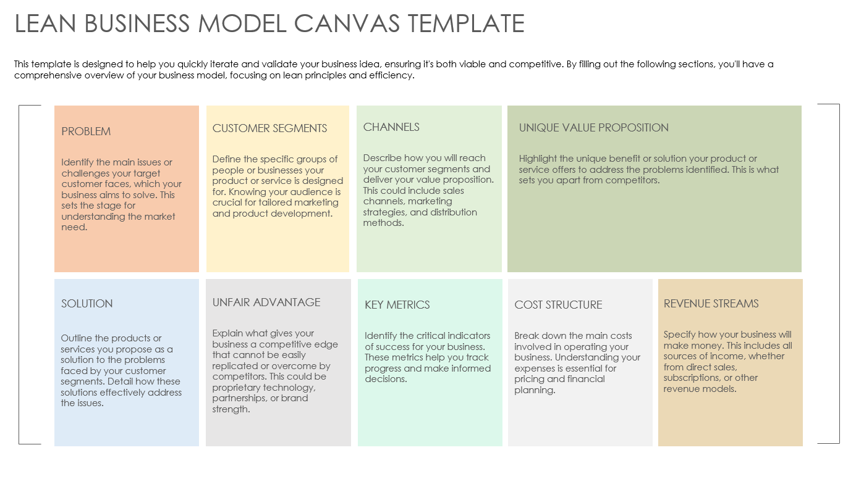
LEAN BUSINESS MODEL CANVAS TEMPLATE
for PowerPoint

Slide 2
LEAN BUSINESS MODEL CANVAS TEMPLATE
This template is designed to help you quickly iterate and validate your business idea, ensuring it's both viable and competitive. By filling out the following sections, you'll have a comprehensive overview of your business model, focusing on lean principles and efficiency.
PROBLEM
CUSTOMER SEGMENTS
CHANNELS
UNIQUE VALUE PROPOSITION
Identify the main issues or challenges your target customer faces, which your business aims to solve. This sets the stage for understanding the market need.
Define the specific groups of people or businesses your product or service is designed for. Knowing your audience is crucial for tailored marketing and product development.
Describe how you will reach your customer segments and deliver your value proposition. This could include sales channels, marketing strategies, and distribution methods.
Highlight the unique benefit or solution your product or service offers to address the problems identified. This is what sets you apart from competitors.
SOLUTION
UNFAIR ADVANTAGE
KEY METRICS
COST STRUCTURE
REVENUE STREAMS
Outline the products or services you propose as a solution to the problems faced by your customer segments. Detail how these solutions effectively address the issues.
Explain what gives your business a competitive edge that cannot be easily replicated or overcome by competitors. This could be proprietary technology, partnerships, or brand strength.
Identify the critical indicators of success for your business. These metrics help you track progress and make informed decisions.
Break down the main costs involved in operating your business. Understanding your expenses is essential for pricing and financial planning.
Specify how your business will make money. This includes all sources of income, whether from direct sales, subscriptions, or other revenue models.

Slide 3
DISCLAIMER Any articles, templates, or information provided by Smartsheet on the website are for reference only. While we strive to keep the information up to date and correct, we make no representations or warranties of any kind, express or implied, about the completeness, accuracy, reliability, suitability, or availability with respect to the website or the information, articles, templates, or related graphics contained on the website. Any reliance you place on such information is therefore strictly at your own risk.

