Slide 1
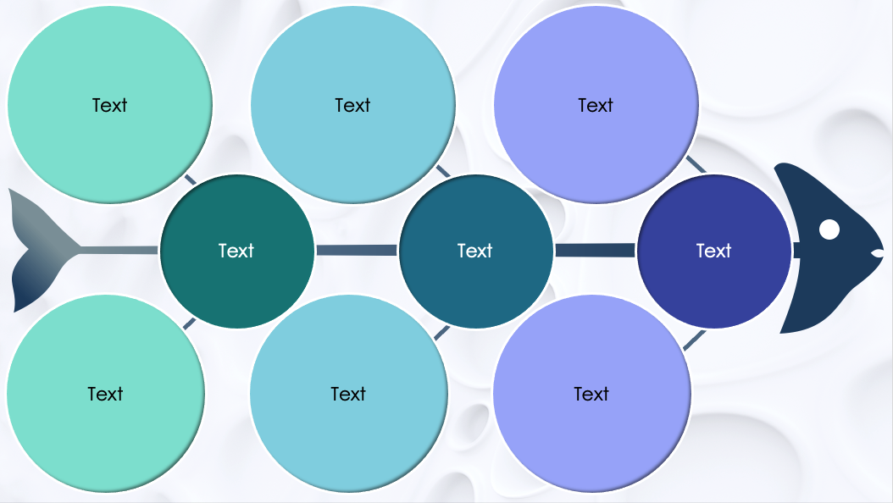
PowerPoint Circles Fishbone Diagram Template
When to Use This Template: This fishbone template is perfect for interactive sessions and presentations aimed at pinpointing and discussing the root causes of business challenges. Use it in workshops aimed at improving business operations or to help teams collaboratively map out the various factors contributing to a particular issue during project planning or review.
Notable Template Features: This template replaces the traditional linear bones of a fishbone diagram with interconnected circles, streamlining complex data into an accessible visual format. The circles act as focal points that draw attention to key information. Each circle allows for the concise summary of an idea, creating a clean and organized visual representation of potential causes.

Slide 2
Text
Text
Text
Text
Text
Text
Text
Text
Text

Slide 3
DISCLAIMER Any articles, templates, or information provided by Smartsheet on the website are for reference only. While we strive to keep the information up to date and correct, we make no representations or warranties of any kind, express or implied, about the completeness, accuracy, reliability, suitability, or availability with respect to the website or the information, articles, templates, or related graphics contained on the website. Any reliance you place on such information is therefore strictly at your own risk.

