Slide 1

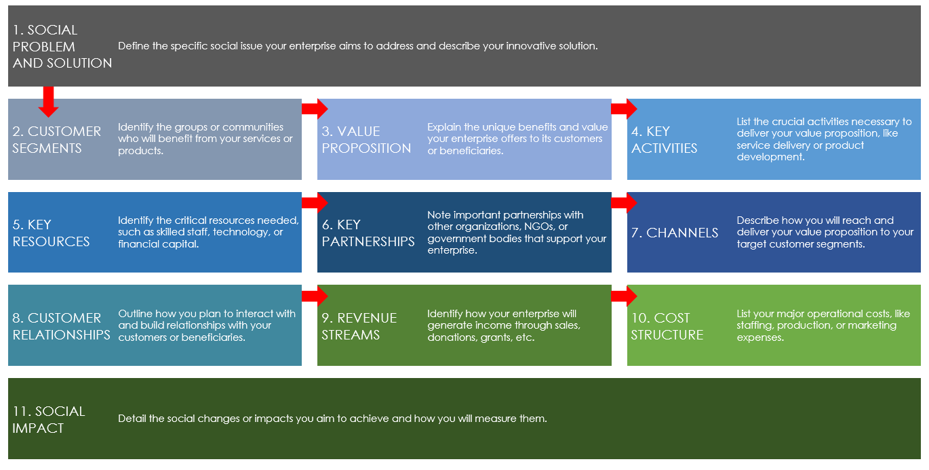
SOCIAL ENTERPRISE CANVAS TEMPLATE
for PowerPoint
These instructions will guide you in creating a comprehensive business model for your social enterprise, aligning your social goals with sustainable business practices.

Slide 2
SOCIAL ENTERPRISE BUSINESS MODEL CANVAS TEMPLATE
1. SOCIAL PROBLEM AND SOLUTION | Define the specific social issue your enterprise aims to address and describe your innovative solution.
2. CUSTOMER SEGMENTS | Identify the groups or communities who will benefit from your services or products. |  | 3. VALUE PROPOSITION | Explain the unique benefits and value your enterprise offers to its customers or beneficiaries. |  | 4. KEY ACTIVITIES | List the crucial activities necessary to deliver your value proposition, like service delivery or product development.
5. KEY RESOURCES | Identify the critical resources needed, such as skilled staff, technology, or financial capital. |  | 6. KEY PARTNERSHIPS | Note important partnerships with other organizations, NGOs, or government bodies that support your enterprise. |  | 7. CHANNELS | Describe how you will reach and deliver your value proposition to your target customer segments.
8. CUSTOMER RELATIONSHIPS | Outline how you plan to interact with and build relationships with your customers or beneficiaries. |  | 9. REVENUE STREAMS | Identify how your enterprise will generate income through sales, donations, grants, etc. |  | 10. COST STRUCTURE | List your major operational costs, like staffing, production, or marketing expenses.
11. SOCIAL IMPACT | Detail the social changes or impacts you aim to achieve and how you will measure them.

Slide 3
DISCLAIMER Any articles, templates, or information provided by Smartsheet on the website are for reference only. While we strive to keep the information up to date and correct, we make no representations or warranties of any kind, express or implied, about the completeness, accuracy, reliability, suitability, or availability with respect to the website or the information, articles, templates, or related graphics contained on the website. Any reliance you place on such information is therefore strictly at your own risk.

