Slide 1
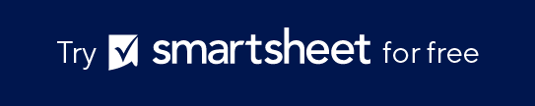
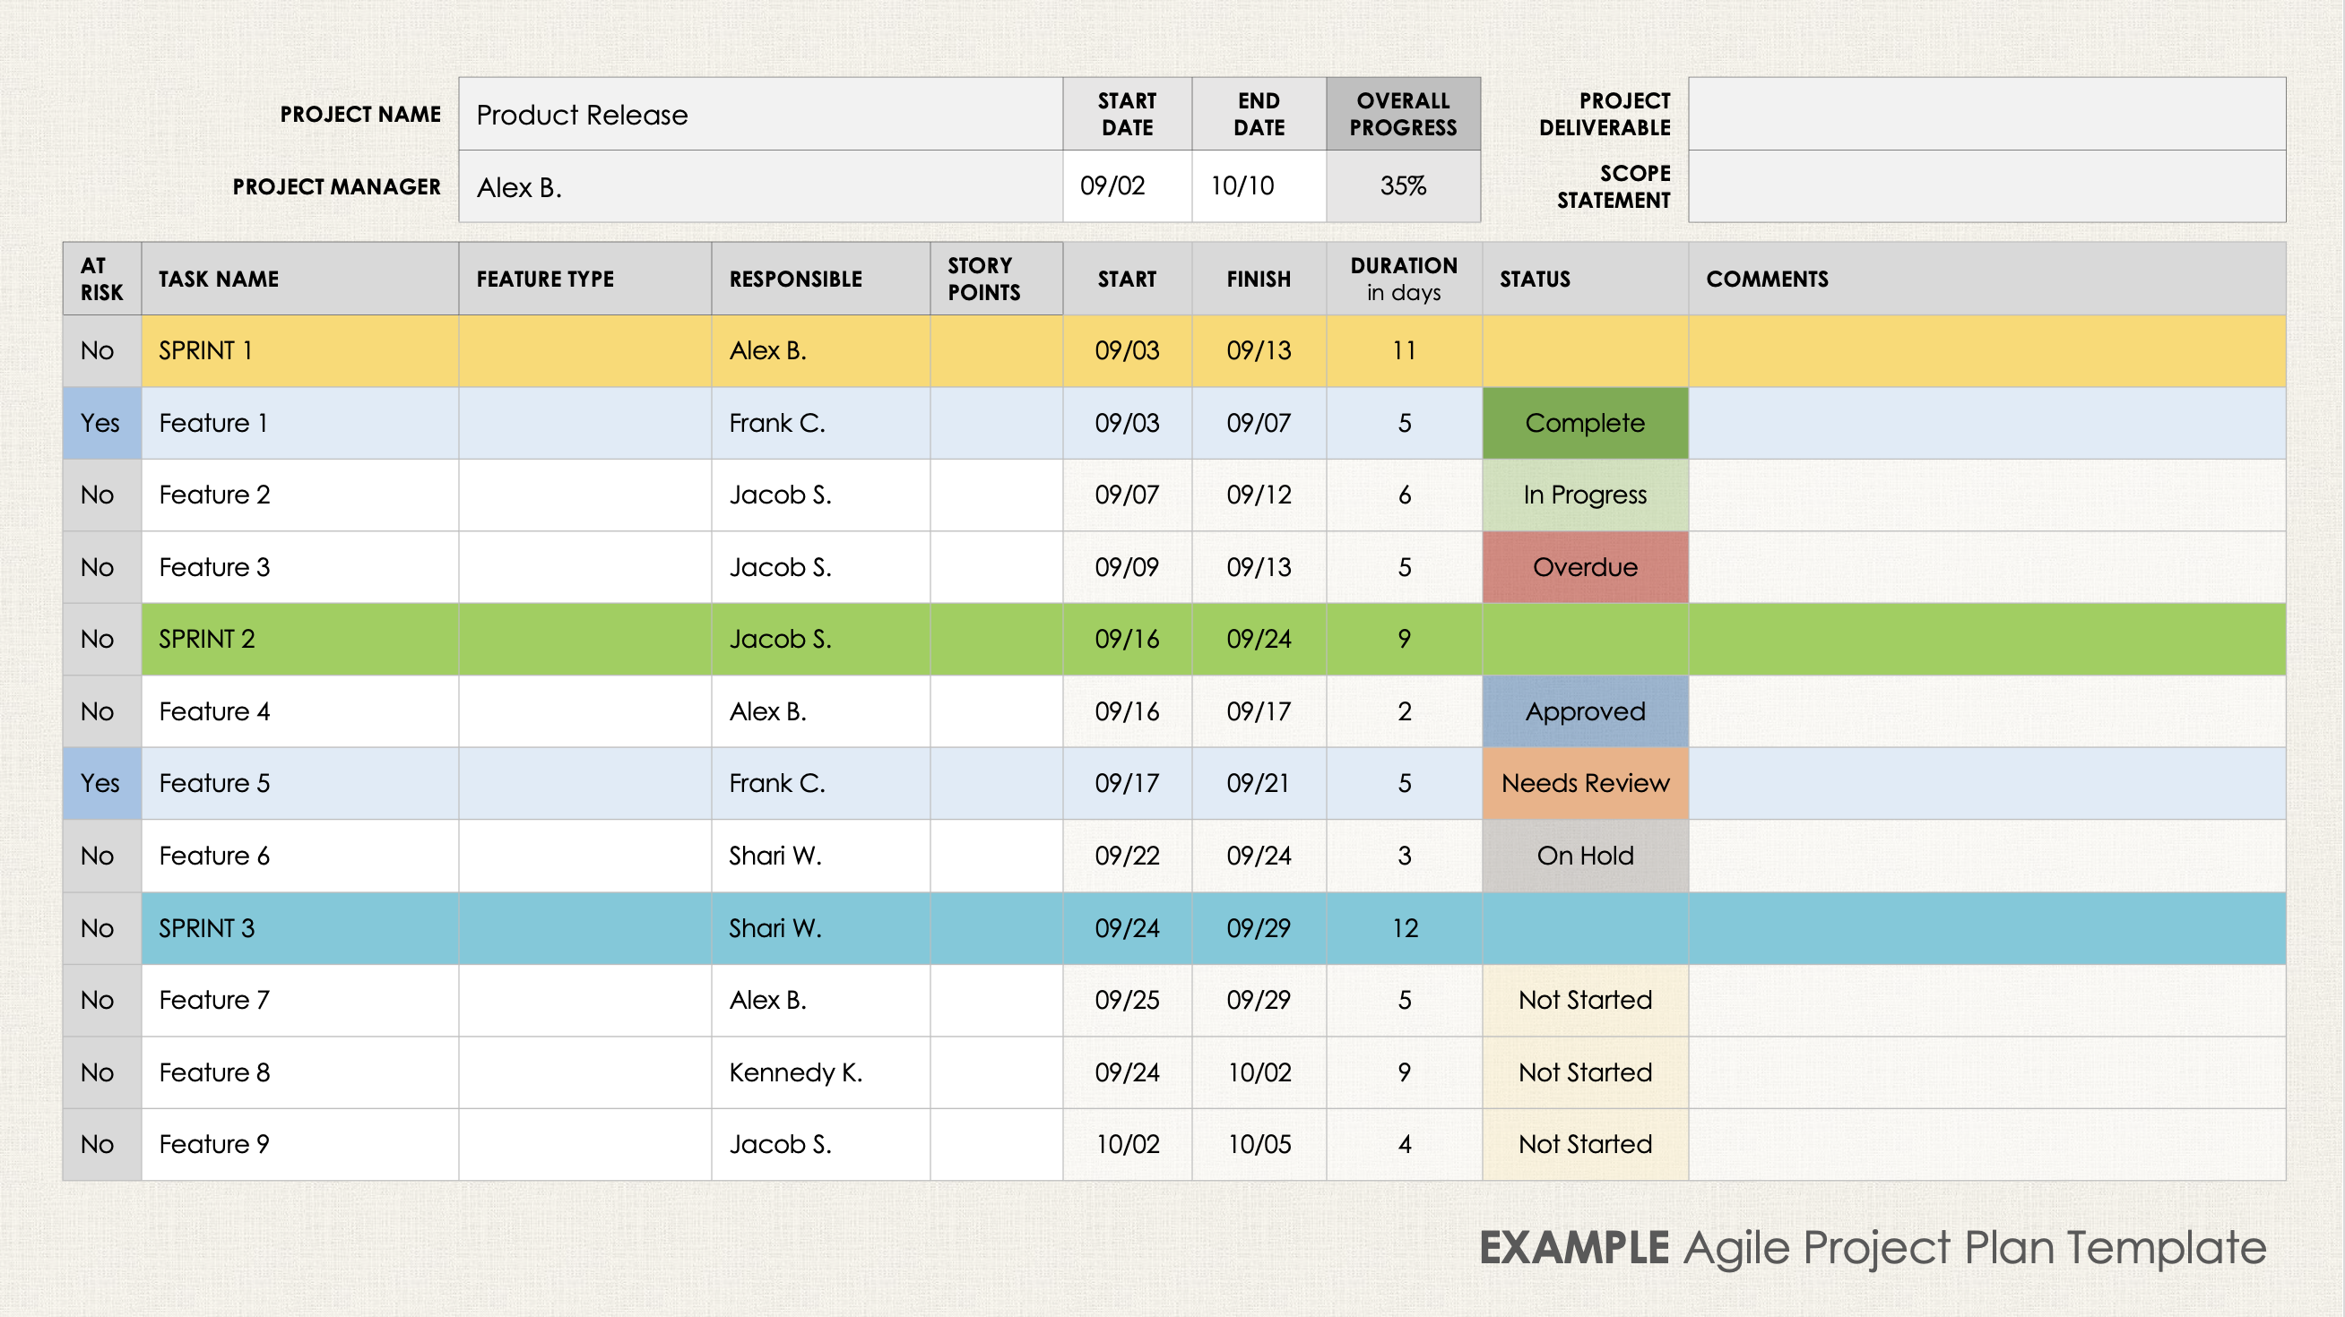
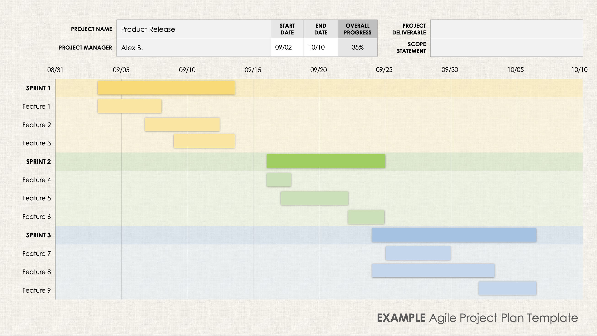
Agile Project Plan Template
When to Use This Template: Use this two-slide template to share the details of an Agile project plan with your team and stakeholders. It provides a clear picture of the project’s journey over a specific timeline and is available blank or with sample data, so you can customize it to fit your needs.
Notable Template Features: On the first slide, enter the project deliverables and scope. The template also provides space to list the project tasks, owners, start and end dates, and task status. Use the Risk column to indicate whether a task runs the chance of being overdue, and visualize your sprints with the customizable, color-coded bar chart on the second slide.

Slide 2
PROJECT NAME |  | START DATE | END DATE | OVERALL PROGRESS | PROJECT DELIVERABLE
PROJECT MANAGER |  |  |  |  | SCOPE STATEMENT
AT RISK | TASK NAME | FEATURE TYPE | RESPONSIBLE | STORY POINTS | START | FINISH | DURATION in days | STATUS | COMMENTS
No | SPRINT 1
Yes | Feature 1
No | Feature 2
No | Feature 3
No | SPRINT 2
No | Feature 4
Yes | Feature 5
No | Feature 6
No | SPRINT 3
No | Feature 7
No | Feature 8
No | Feature 9
Agile Project Plan Template

Slide 3
PROJECT NAME |  | START DATE | END DATE | OVERALL PROGRESS | PROJECT DELIVERABLE
PROJECT MANAGER |  |  |  |  | SCOPE STATEMENT
08/31
09/05
09/10
09/15
09/20
09/25
09/30
10/05
10/10
SPRINT 1
Feature 1
Feature 2
Feature 3
SPRINT 2
Feature 4
Feature 5
Feature 6
SPRINT 3
Feature 7
Feature 8
Feature 9
Agile Project Plan Template

Slide 4
PROJECT NAME | Product Release | START DATE | END DATE | OVERALL PROGRESS | PROJECT DELIVERABLE
PROJECT MANAGER | Alex B. | 09/02 | 10/10 | 35% | SCOPE STATEMENT
AT RISK | TASK NAME | FEATURE TYPE | RESPONSIBLE | STORY POINTS | START | FINISH | DURATION in days | STATUS | COMMENTS
No | SPRINT 1 |  | Alex B. |  | 09/03 | 09/13 | 11
Yes | Feature 1 |  | Frank C. |  | 09/03 | 09/07 | 5 | Complete
No | Feature 2 |  | Jacob S. |  | 09/07 | 09/12 | 6 | In Progress
No | Feature 3 |  | Jacob S. |  | 09/09 | 09/13 | 5 | Overdue
No | SPRINT 2 |  | Jacob S. |  | 09/16 | 09/24 | 9
No | Feature 4 |  | Alex B. |  | 09/16 | 09/17 | 2 | Approved
Yes | Feature 5 |  | Frank C. |  | 09/17 | 09/21 | 5 | Needs Review
No | Feature 6 |  | Shari W. |  | 09/22 | 09/24 | 3 | On Hold
No | SPRINT 3 |  | Shari W. |  | 09/24 | 09/29 | 12
No | Feature 7 |  | Alex B. |  | 09/25 | 09/29 | 5 | Not Started
No | Feature 8 |  | Kennedy K. |  | 09/24 | 10/02 | 9 | Not Started
No | Feature 9 |  | Jacob S. |  | 10/02 | 10/05 | 4 | Not Started
EXAMPLE Agile Project Plan Template

Slide 5
PROJECT NAME | Product Release | START DATE | END DATE | OVERALL PROGRESS | PROJECT DELIVERABLE
PROJECT MANAGER | Alex B. | 09/02 | 10/10 | 35% | SCOPE STATEMENT
08/31
09/05
09/10
09/15
09/20
09/25
09/30
10/05
10/10
SPRINT 1
Feature 1
Feature 2
Feature 3
SPRINT 2
Feature 4
Feature 5
Feature 6
SPRINT 3
Feature 7
Feature 8
Feature 9
EXAMPLE Agile Project Plan Template

Slide 6
DISCLAIMER Any articles, templates, or information provided by Smartsheet on the website are for reference only. While we strive to keep the information up to date and correct, we make no representations or warranties of any kind, express or implied, about the completeness, accuracy, reliability, suitability, or availability with respect to the website or the information, articles, templates, or related graphics contained on the website. Any reliance you place on such information is therefore strictly at your own risk.

