Slide 1

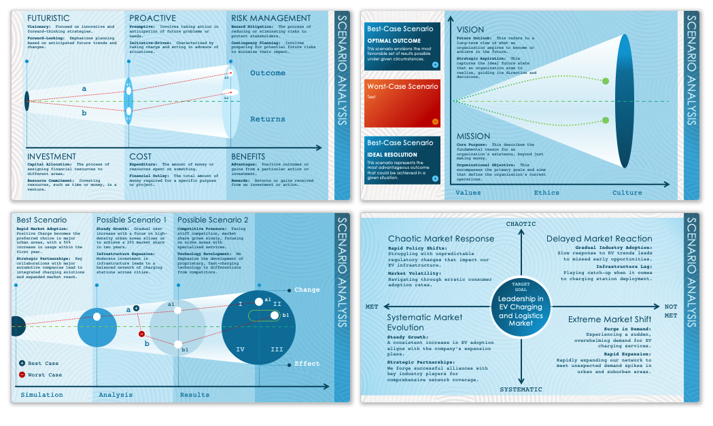
Business Analysis Scenario Template
When to Use This Template: Employ this business analysis scenario template with or without sample data to present a detailed assessment of complex business scenarios, such as shifts in market dynamics or competitive landscapes, to your team or stakeholders. It's particularly useful for business analysts and corporate strategists who need to convey business environment analyses during strategic planning meetings or executive briefings.
Notable Template Features: This template features comprehensive slide layouts that facilitate a clear, thorough exploration of various business scenarios. Its standout attributes include dedicated sections for detailing market trends, competitive analysis, and strategic implications, complemented by engaging visual elements.

Slide 2

FUTURISTIC
PROACTIVE
RISK MANAGEMENT
Text:
Text
Text:
Text
Text:
Text
Outcome
a2
a
a1
b2
b
b1
Returns
INVESTMENT
COST
BENEFITS
Text:
Text
Text:
Text
Text:
Text

Slide 3
Best-Case Scenario
VISION
OPTIMAL OUTCOME
This scenario envisions the most favorable set of results possible under given circumstances.
Text:
Text
Worst-Case Scenario
Text
MISSION
Best-Case Scenario
Text:
Text
IDEAL RESOLUTION
This scenario represents the most advantageous outcome that could be achieved in a given situation.
Values
Ethics
Culture

Slide 4
Best Scenario
Possible Scenario 1
Possible Scenario 2
Text:
Text
Text:
Text
Text:
Text
Change
I
a1
a1
II
a
b1
b
b1
IV
III
Best Case
Effect
Worst Case
Simulation
Analysis
Results

Slide 5
CHAOTIC
Chaotic Response
Delayed Reaction
Text:
Text
Text:
Text
TARGET GOAL
MET
NOTMET
Text
Systematic Evolution
Extreme Shift
Text:
Text
Text:
Text
SYSTEMATIC

Slide 6
DISCLAIMER Any articles, templates, or information provided by Smartsheet on the website are for reference only. While we strive to keep the information up to date and correct, we make no representations or warranties of any kind, express or implied, about the completeness, accuracy, reliability, suitability, or availability with respect to the website or the information, articles, templates, or related graphics contained on the website. Any reliance you place on such information is therefore strictly at your own risk.

