Slide 1
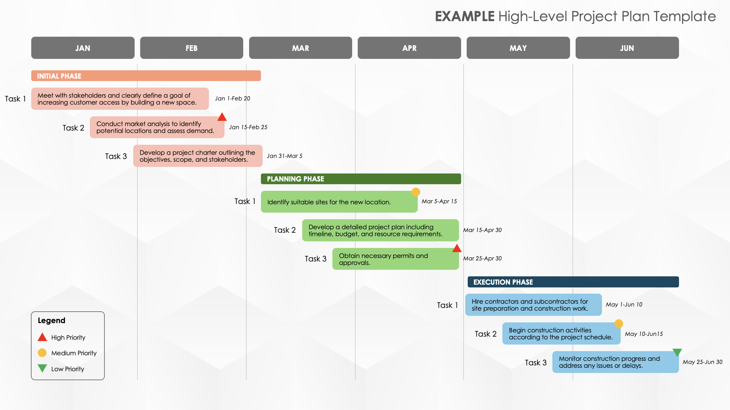
High-Level Project Plan Template
When to Use This Template: This high-level, single-slide project plan template is ideal for tracking and communicating project timeline tasks and milestones within each project phase. Use this template to inform stakeholders about the project’s progress.
Notable Template Features: This template, available with sample data and as a blank option, provides a six-month timeline that, differentiates the project phases with colors and uses icons to highlight project milestones. You can also designate priority level using icons (high, medium, low), and customize the display of the phases, task timelines, colors, and milestone icons.

Slide 2
High-Level Project Plan Template
JAN
FEB
MAR
APR
MAY
JUN
PHASE NAME
Task 1
Description
Dates
Task 2
Description
Dates
Task 3
Description
Dates
PHASE NAME
Task 1
Description
Dates
Task 2
Description
Dates
Task 3
Description
Dates
PHASE NAME
Task 1
Description
Dates
Legend
Task 2
Description
Dates
High Priority
Medium Priority
Description
Low Priority
Task 3
Dates

Slide 3
EXAMPLE High-Level Project Plan Template
JAN
FEB
MAR
APR
MAY
JUN
INITIAL PHASE
Task 1
Meet with stakeholders and clearly define a goal of increasing customer access by building a new space.
Jan 1-Feb 20
Task 2
Conduct market analysis to identify potential locations and assess demand.
Jan 15-Feb 25
Task 3
Develop a project charter outlining the objectives, scope, and stakeholders.
Jan 31-Mar 5
PLANNING PHASE
Task 1
Identify suitable sites for the new location.
Mar 5-Apr 15
Task 2
Develop a detailed project plan including timeline, budget, and resource requirements.
Mar 15-Apr 30
Task 3
Obtain necessary permits and approvals.
Mar 25-Apr 30
EXECUTION PHASE
Task 1
Hire contractors and subcontractors for site preparation and construction work.
May 1-Jun 10
Legend
Task 2
Begin construction activities according to the project schedule.
May 10-Jun15
High Priority
Medium Priority
Monitor construction progress and address any issues or delays.
Low Priority
Task 3
May 25-Jun 30

Slide 4
DISCLAIMER Any articles, templates, or information provided by Smartsheet on the website are for reference only. While we strive to keep the information up to date and correct, we make no representations or warranties of any kind, express or implied, about the completeness, accuracy, reliability, suitability, or availability with respect to the website or the information, articles, templates, or related graphics contained on the website. Any reliance you place on such information is therefore strictly at your own risk.

