Slide 1

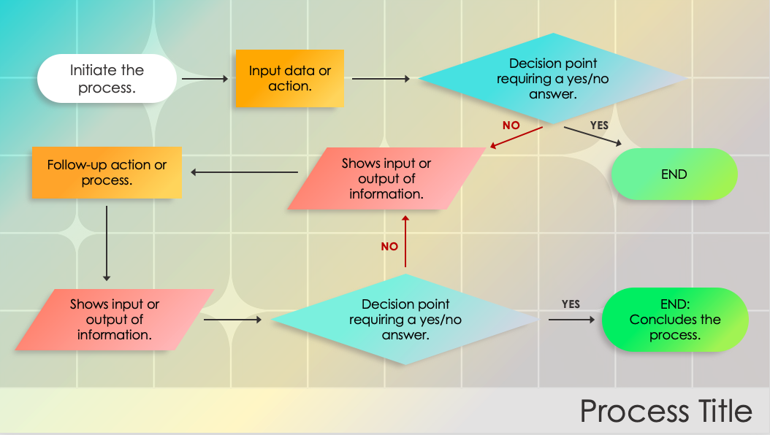
PowerPoint Animated Flowchart Template
When to Use This Template: Opt for this animated flowchart template for PowerPoint when you want to make your presentations more engaging with movement, especially in scenarios where you're explaining complex workflows or processes that need extra clarity.
Notable Template Features: This animated flowchart template for PowerPoint template comes alive with animations that guide viewers through each step of a process, making it easier to understand and remember. It’s designed for anyone to use, enhancing presentations with visually appealing elements that grab and hold attention.

Slide 2
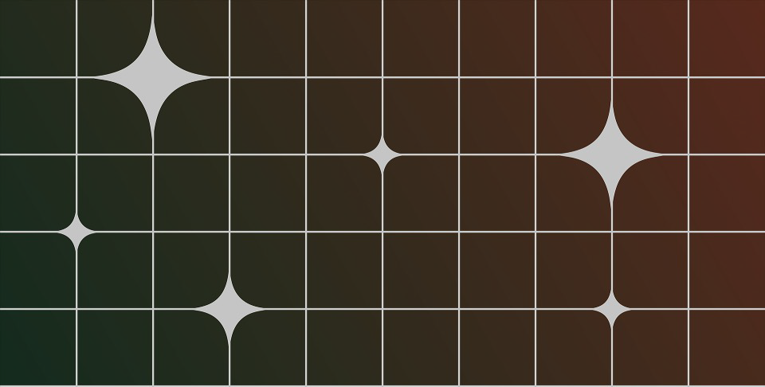
Decision point requiring a yes/no answer.
Initiate the process.
Input data or action.
NO
YES
Follow-up action or process.
Shows input or output of information.
END
NO
Decision point requiring a yes/no answer.
Shows input or output of information.
YES
END:
Concludes the process.
Process Title

Slide 3
DISCLAIMER Any articles, templates, or information provided by Smartsheet on the website are for reference only. While we strive to keep the information up to date and correct, we make no representations or warranties of any kind, express or implied, about the completeness, accuracy, reliability, suitability, or availability with respect to the website or the information, articles, templates, or related graphics contained on the website. Any reliance you place on such information is therefore strictly at your own risk.

