Slide 1

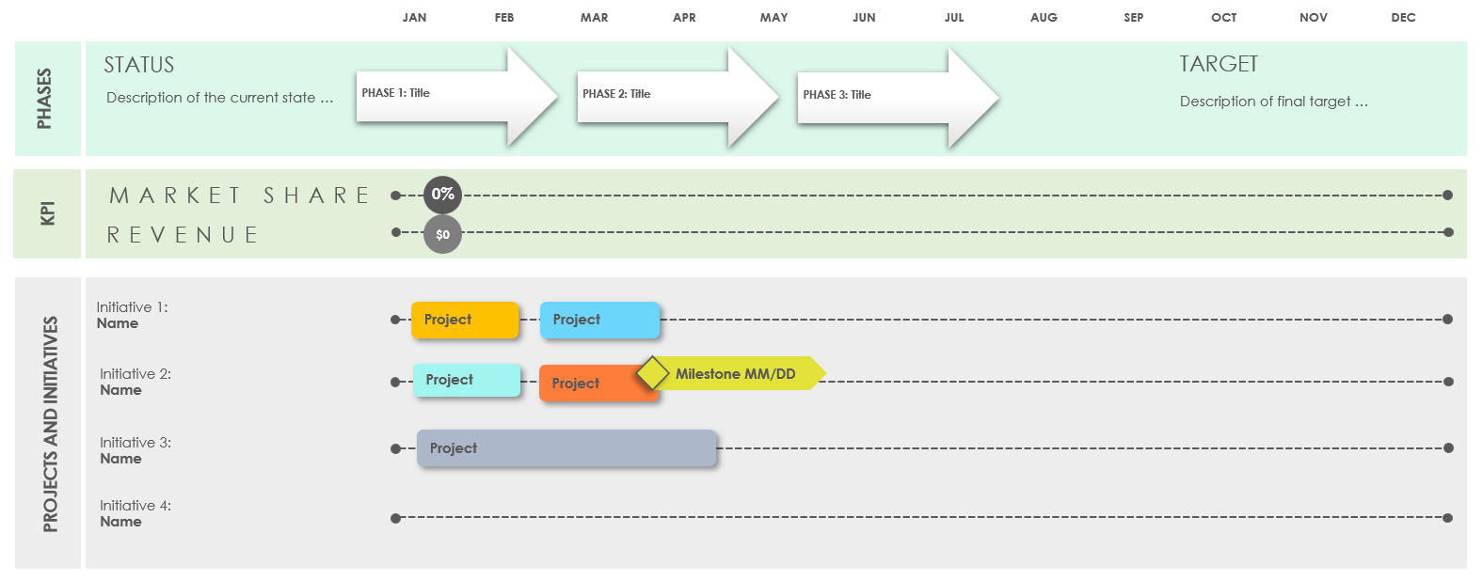
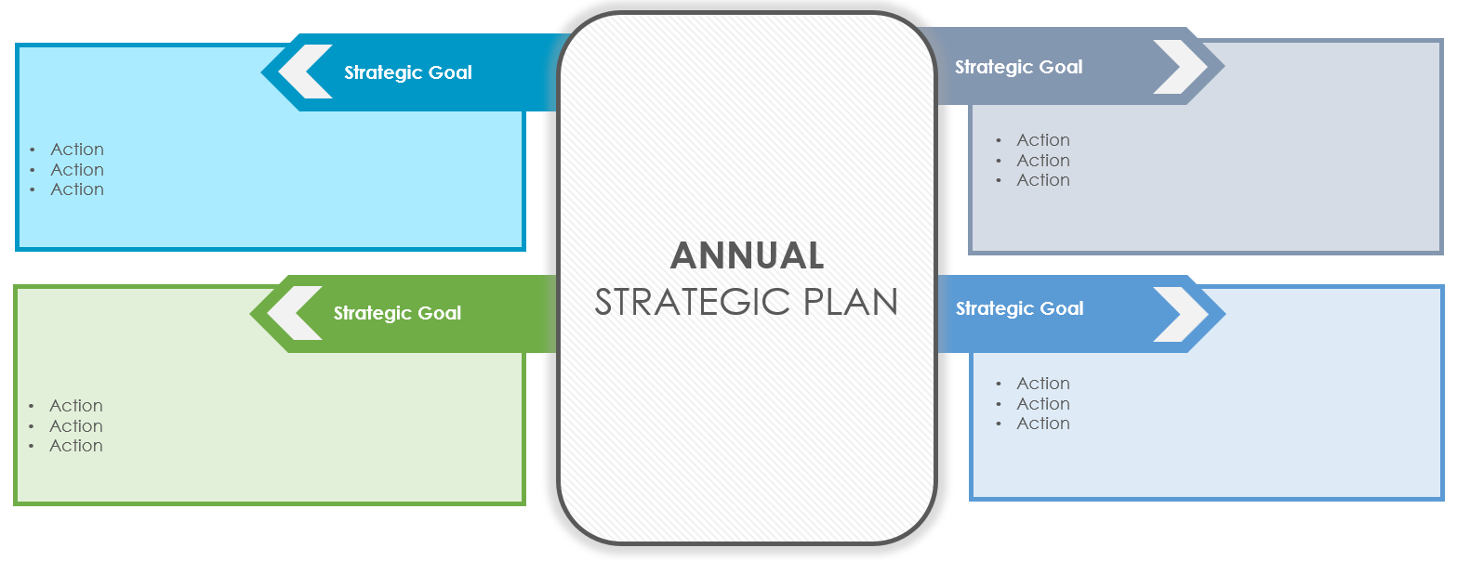
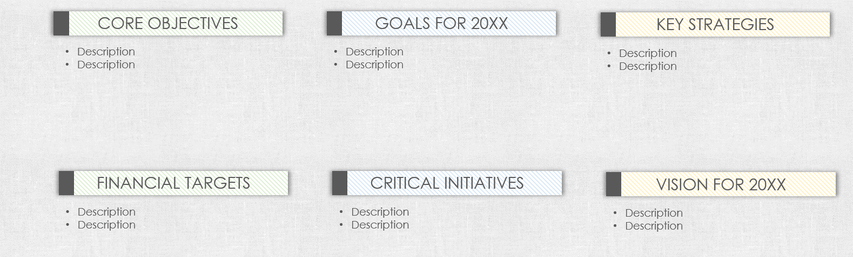
PowerPoint Annual Strategic Plan Template
Streamline your annual strategic plan presentation into a concise PowerPoint format using one to three slides. This template helps you structure your presentation to deliver clear, actionable information.

Slide 2


Annual Strategic Plan Executive Summary for 20XX
Begin with an executive summary that provides high-level insights into your strategic priorities, focusing on the 'why' behind your annual goals and their impact on your overall strategic vision. Outline the core objectives and goals for the year, highlight key strategies that will drive the business forward, and provide a succinct overview of targeted financial performance and critical initiatives.
CORE OBJECTIVES
GOALS FOR 20XX
KEY STRATEGIES
Description
Description
Description
Description
Description
Description
FINANCIAL TARGETS
CRITICAL INITIATIVES
VISION FOR 20XX
Description
Description
Description
Description
Description
Description
1. EXECUTIVE SUMMARY FOR 20XX

Slide 3
Key Objectives and Initiatives (Optional)
Detail the specific objectives for the year, aligning them with your overarching strategic plan. For each goal, link actionable steps and assign responsibilities. Use bullet points for clarity in outlining objectives and initiatives, ensuring that each is specific and measurable.
ANNUAL STRATEGIC PLAN
Strategic Goal
Strategic Goal
Action
Action
Action
Action
Action
Action
Strategic Goal
Strategic Goal
Action
Action
Action
Action
Action
Action
2. KEY OBJECTIVES AND INITIATIVES FOR 20XX

Slide 4
Implementation Roadmap
Present a timeline of major milestones and deliverables for the year, outlining key performance indicators (KPIs) to measure progress towards each objective. Highlight critical dependencies and risks. This roadmap is a dynamic visual tool. Keep it regularly updated to reflect changes and progress.
JAN | FEB | MAR | APR | MAY | JUN | JUL | AUG | SEP | OCT | NOV | DEC
STATUS
TARGET
PHASES
Description of the current state …
PHASE 1: Title
PHASE 2: Title
PHASE 3: Title
Description of final target …
MARKET SHARE
0%
KPI
REVENUE
$0
Initiative 1:
Name
Project
Project
Initiative 2:
Name
Project
Project
Milestone MM/DD
PROJECTS AND INITIATIVES
Initiative 3:
Name
Project
Initiative 4:
Name
TASK OWNER
TASK OWNER
TASK OWNER
TASK OWNER
TASK OWNER
Milestone MM/DD
3. IMPLEMENTATION ROADMAP FOR 20XX

Slide 5
DISCLAIMER Any articles, templates, or information provided by Smartsheet on the website are for reference only. While we strive to keep the information up to date and correct, we make no representations or warranties of any kind, express or implied, about the completeness, accuracy, reliability, suitability, or availability with respect to the website or the information, articles, templates, or related graphics contained on the website. Any reliance you place on such information is therefore strictly at your own risk.

