Slide 1

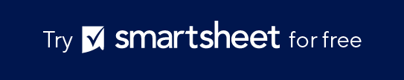
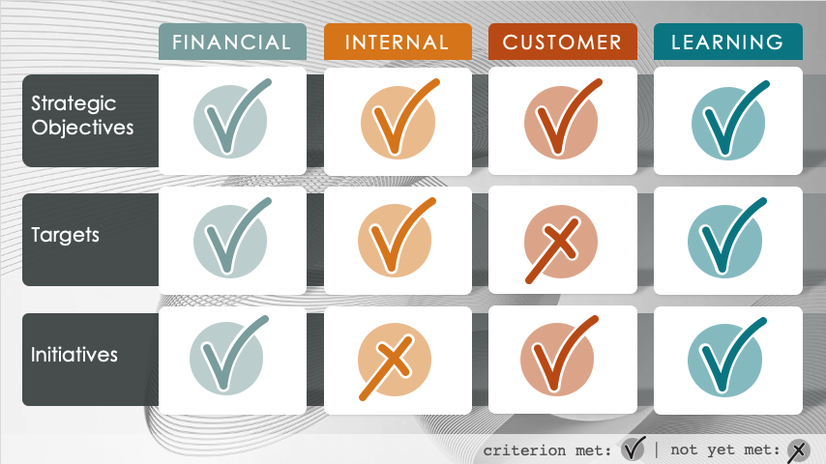
PowerPoint Balanced Scorecard Check Mark Template
When to Use This Template: Present a simplified status report of strategic objectives across different functional areas. Use this template for management reviews, team meetings, and any situation where a quick visual update is required. The template is designed to help you communicate the status of each area (i.e., whether it’s meeting objectives, hitting targets, and performing well or poorly) in a snapshot format.
Notable Template Features: Each category in this balanced scorecard template is divided into rows for objectives, targets, and status, with check marks indicating whether each criterion has been met. The color-coded system provides an instant visual cue to viewers, allowing for easy interpretation of the organization's performance in key strategic areas.

Slide 2
FINANCIAL
INTERNAL
CUSTOMER
LEARNING
Strategic Objectives
Targets
Initiatives
criterion met:
| not yet met:

Slide 3
FINANCIAL
INTERNAL
CUSTOMER
LEARNING
Strategic Objectives
Targets
Initiatives
criterion met:
| not yet met:

Slide 4
FINANCIAL
INTERNAL
CUSTOMER
LEARNING
Strategic Objectives
Targets
Initiatives
criterion met:
| not yet met:

Slide 5
DISCLAIMER Any articles, templates, or information provided by Smartsheet on the website are for reference only. While we strive to keep the information up to date and correct, we make no representations or warranties of any kind, express or implied, about the completeness, accuracy, reliability, suitability, or availability with respect to the website or the information, articles, templates, or related graphics contained on the website. Any reliance you place on such information is therefore strictly at your own risk.

