Slide 1


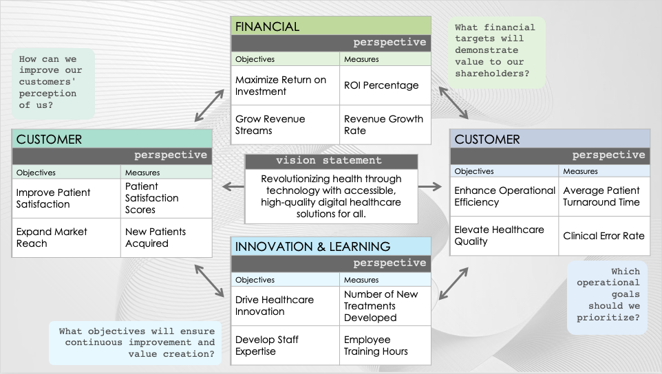
PowerPoint Balanced Scorecard KPI Template
When to Use This Template: This balanced scorecard template is tailored for organizations aiming to establish and communicate clear goals and KPIs across different business areas. The template is especially useful in strategic planning sessions where leaders can define and align their vision with measurable outcomes. Teams across all levels can utilize this template to ensure that their objectives support the overall direction of the organization.
Notable Template Features: This template features four distinct colored blocks representing the core areas of a balanced scorecard: financial, customer, internal processes, and innovation and learning. Each block offers space for adding goals and their corresponding measures, linking KPIs with desired outcomes. The center of the template is reserved for a vision statement, which ties all areas together and reinforces the strategic intent behind the goals and measures.

Slide 2
FINANCIAL
perspective
Objectives | Measures
Maximize Return on Investment | ROI Percentage
Grow Revenue Streams | Revenue Growth Rate
What financial targets will demonstrate value to our shareholders?
How can we improve our customers' perception of us?
CUSTOMER
perspective
Objectives | Measures
Improve Patient Satisfaction | Patient Satisfaction Scores
Expand Market Reach | New Patients Acquired
CUSTOMER
perspective
Objectives | Measures
Enhance Operational Efficiency | Average Patient Turnaround Time
Elevate Healthcare Quality | Clinical Error Rate
vision statement
Revolutionizing health through technology with accessible, high-quality digital healthcare solutions for all.
INNOVATION & LEARNING
perspective
Objectives | Measures
Drive Healthcare Innovation | Number of New Treatments Developed
Develop Staff Expertise | Employee Training Hours
Which operational goals
should we prioritize?
What objectives will ensure continuous improvement and value creation?

Slide 3
FINANCIAL
perspective
Objectives | Measures
What financial targets will demonstrate value to our shareholders?
How can we improve our customers' perception of us?
CUSTOMER
perspective
Objectives | Measures
CUSTOMER
perspective
Objectives | Measures
vision statement
INNOVATION & LEARNING
perspective
Objectives | Measures
Which operational goals
should we prioritize?
What objectives will ensure continuous improvement and value creation?

Slide 4
DISCLAIMER Any articles, templates, or information provided by Smartsheet on the website are for reference only. While we strive to keep the information up to date and correct, we make no representations or warranties of any kind, express or implied, about the completeness, accuracy, reliability, suitability, or availability with respect to the website or the information, articles, templates, or related graphics contained on the website. Any reliance you place on such information is therefore strictly at your own risk.

