Slide 1


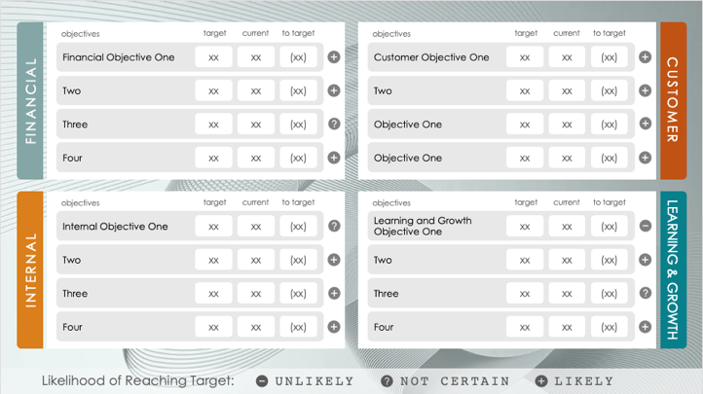
PowerPoint Balanced Scorecard Matrix Template
When to Use This Template: This balanced scorecard template tracks business performance across various objectives. During periodic reviews, managers and team leaders can use this template to communicate progress toward strategic targets and ensure alignment with overarching goals and strategies.
Notable Template Features: The template features a clear layout that’s divided into financial, customer, internal, and learning perspectives. Each section contains objectives, targets, and current status, providing a detailed overview in a format that's easy to digest. The matrix layout centers around the broader business vision and strategy, which helps teams understand the linkage between their daily activities and the company's goals.

Slide 2






objectives
target
current
to target
objectives
target
current
to target
Financial Objective One
xx
xx
(xx)
Customer Objective One
xx
xx
(xx)
FINANCIAL
Two
xx
xx
(xx)
Two
xx
xx
(xx)
CUSTOMER
Three
xx
xx
(xx)
Objective One
xx
xx
(xx)
Four
xx
xx
(xx)
Objective One
xx
xx
(xx)
objectives
target
current
to target
objectives
target
current
to target
Internal Objective One
xx
xx
(xx)
Learning and Growth Objective One
xx
xx
(xx)
INTERNAL
Two
xx
xx
(xx)
Two
xx
xx
(xx)
LEARNING & GROWTH
Three
xx
xx
(xx)
Three
xx
xx
(xx)
Four
xx
xx
(xx)
Four
xx
xx
(xx)
Likelihood of Reaching Target:
UNLIKELY
NOT CERTAIN
LIKELY

Slide 3
DISCLAIMER Any articles, templates, or information provided by Smartsheet on the website are for reference only. While we strive to keep the information up to date and correct, we make no representations or warranties of any kind, express or implied, about the completeness, accuracy, reliability, suitability, or availability with respect to the website or the information, articles, templates, or related graphics contained on the website. Any reliance you place on such information is therefore strictly at your own risk.

