Slide 1
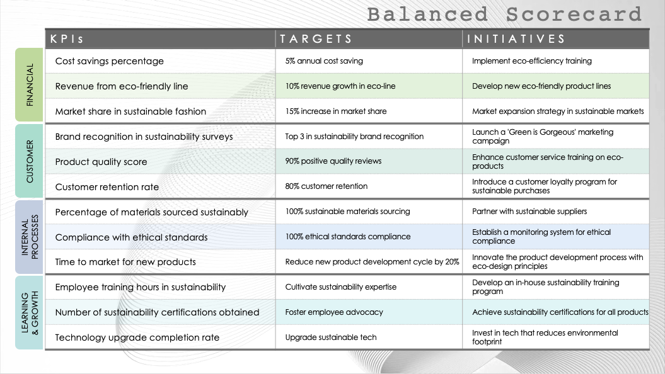
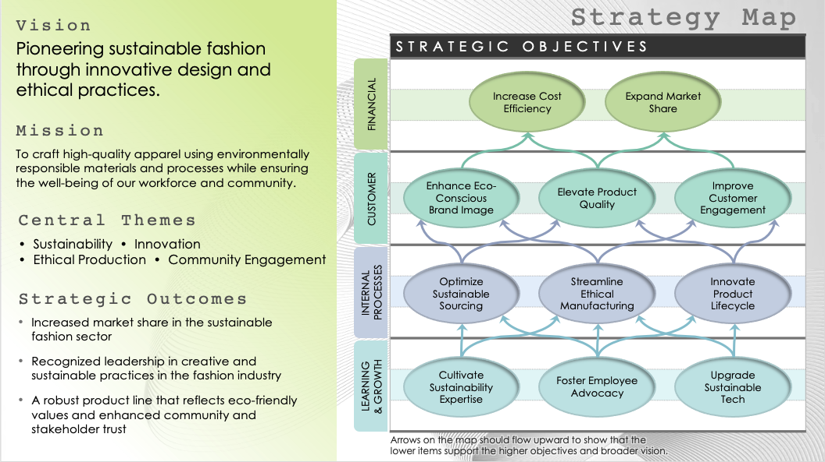
PowerPoint Integrated Balanced Scorecard Template
When to Use This Template: This integrated balanced scorecard is a comprehensive tool for businesses to link their strategic planning with execution. Use the template for annual planning sessions, quarterly reviews, and strategy workshops where teams align their objectives with measurable targets and required actions. This scorecard is designed for mapping out and communicating strategies clearly across all levels of the organization.
Notable Template Features: This template includes a strategy map, a balanced scorecard, and a section for action planning. The template categorizes objectives into four standard balanced scorecard perspectives: financial, customer, internal processes, and learning and growth, each with space to add strategic goals. The combination of objectives, measurements, targets, and the related initiatives to achieve them allows for a detailed and interconnected presentation of strategy and execution steps.

Slide 2
Strategy Map
Vision
Pioneering sustainable fashion through innovative design and ethical practices.
STRATEGIC OBJECTIVES
Increase Cost Efficiency
Expand Market Share
FINANCIAL
Mission
To craft high-quality apparel using environmentally responsible materials and processes while ensuring the well-being of our workforce and community.
Enhance Eco-Conscious Brand Image
Elevate Product Quality
Improve Customer Engagement
CUSTOMER
Central Themes
• Sustainability • Innovation
• Ethical Production • Community Engagement
Optimize Sustainable Sourcing
Streamline Ethical Manufacturing
Innovate Product Lifecycle
INTERNAL PROCESSES
Strategic Outcomes
Increased market share in the sustainable fashion sector
Recognized leadership in creative and sustainable practices in the fashion industry
A robust product line that reflects eco-friendly values and enhanced community and stakeholder trust
Cultivate Sustainability Expertise
Foster Employee Advocacy
Upgrade Sustainable Tech
LEARNING & GROWTH
Arrows on the map should flow upward to show that the lower items support the higher objectives and broader vision.

Slide 3
Balanced Scorecard
KPIs | TARGETS | INITIATIVES
Cost savings percentage | 5% annual cost saving | Implement eco-efficiency training
Revenue from eco-friendly line | 10% revenue growth in eco-line | Develop new eco-friendly product lines
Market share in sustainable fashion | 15% increase in market share | Market expansion strategy in sustainable markets
Brand recognition in sustainability surveys | Top 3 in sustainability brand recognition | Launch a 'Green is Gorgeous' marketing campaign
Product quality score | 90% positive quality reviews | Enhance customer service training on eco-products
Customer retention rate | 80% customer retention | Introduce a customer loyalty program for sustainable purchases
Percentage of materials sourced sustainably | 100% sustainable materials sourcing | Partner with sustainable suppliers
Compliance with ethical standards | 100% ethical standards compliance | Establish a monitoring system for ethical compliance
Time to market for new products | Reduce new product development cycle by 20% | Innovate the product development process with eco-design principles
Employee training hours in sustainability | Cultivate sustainability expertise | Develop an in-house sustainability training program
Number of sustainability certifications obtained | Foster employee advocacy | Achieve sustainability certifications for all products
Technology upgrade completion rate | Upgrade sustainable tech | Invest in tech that reduces environmental footprint
FINANCIAL
CUSTOMER
INTERNAL PROCESSES
LEARNING & GROWTH

Slide 4
Strategy Map
Vision
Text
STRATEGIC OBJECTIVES
Text
Text
FINANCIAL
Mission
Text
Text
Text
Text
CUSTOMER
Central Themes
• Text
Text
Text
Text
INTERNAL PROCESSES
Strategic Outcomes
Text
Text
Text
Text
LEARNING & GROWTH
Arrows on the map should flow upward to show that the lower items support the higher objectives and broader vision.

Slide 5
Balanced Scorecard
KPIs | TARGETS | INITIATIVES
FINANCIAL
CUSTOMER
INTERNAL PROCESSES
LEARNING & GROWTH

Slide 6
DISCLAIMER Any articles, templates, or information provided by Smartsheet on the website are for reference only. While we strive to keep the information up to date and correct, we make no representations or warranties of any kind, express or implied, about the completeness, accuracy, reliability, suitability, or availability with respect to the website or the information, articles, templates, or related graphics contained on the website. Any reliance you place on such information is therefore strictly at your own risk.

