Slide 1

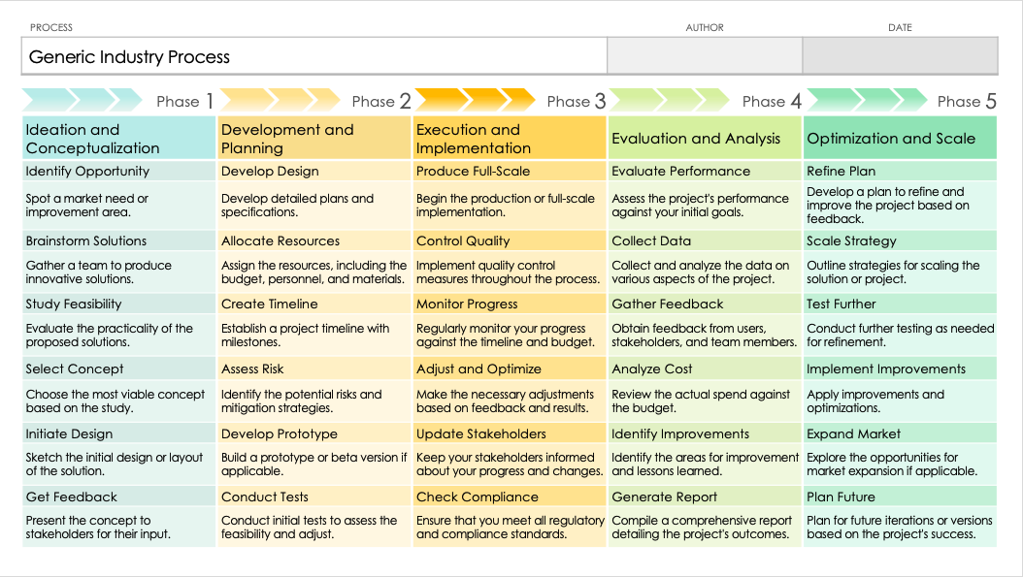
PowerPoint Process Flowchart Template
When to Use This Template: Use this process flowchart template when you need to document or analyze the steps in a specific process. It's ideal for situations requiring a clear, detailed overview of each action and decision point to reach an outcome.
Notable Template Features: This template is designed to offer a comprehensive view, enabling the identification and analysis of every step in a process. Its customizable features allow for the detailed mapping of processes, making it easier to spot inefficiencies and areas for improvement.

Slide 2
PROCESS | AUTHOR | DATE
Generic Industry Process
Phase 1 | Phase 2 | Phase 3 | Phase 4 | Phase 5
Ideation and Conceptualization | Development and Planning | Execution and Implementation | Evaluation and Analysis | Optimization and Scale
Identify Opportunity | Develop Design | Produce Full-Scale | Evaluate Performance | Refine Plan
Spot a market need or improvement area. | Develop detailed plans and specifications. | Begin the production or full-scale implementation. | Assess the project's performance against your initial goals. | Develop a plan to refine and improve the project based on feedback.
Brainstorm Solutions | Allocate Resources | Control Quality | Collect Data | Scale Strategy
Gather a team to produce innovative solutions. | Assign the resources, including the budget, personnel, and materials. | Implement quality control measures throughout the process. | Collect and analyze the data on various aspects of the project. | Outline strategies for scaling the solution or project.
Study Feasibility | Create Timeline | Monitor Progress | Gather Feedback | Test Further
Evaluate the practicality of the proposed solutions. | Establish a project timeline with milestones. | Regularly monitor your progress against the timeline and budget. | Obtain feedback from users, stakeholders, and team members. | Conduct further testing as needed for refinement.
Select Concept | Assess Risk | Adjust and Optimize | Analyze Cost | Implement Improvements
Choose the most viable concept based on the study. | Identify the potential risks and mitigation strategies. | Make the necessary adjustments based on feedback and results. | Review the actual spend against the budget. | Apply improvements and optimizations.
Initiate Design | Develop Prototype | Update Stakeholders | Identify Improvements | Expand Market
Sketch the initial design or layout of the solution. | Build a prototype or beta version if applicable. | Keep your stakeholders informed about your progress and changes. | Identify the areas for improvement and lessons learned. | Explore the opportunities for market expansion if applicable.
Get Feedback | Conduct Tests | Check Compliance | Generate Report | Plan Future
Present the concept to stakeholders for their input. | Conduct initial tests to assess the feasibility and adjust. | Ensure that you meet all regulatory and compliance standards. | Compile a comprehensive report detailing the project's outcomes. | Plan for future iterations or versions based on the project's success.

Slide 3
PROCESS | AUTHOR | DATE
Phase 1 | Phase 2 | Phase 3 | Phase 4 | Phase 5

Slide 4
DISCLAIMER Any articles, templates, or information provided by Smartsheet on the website are for reference only. While we strive to keep the information up to date and correct, we make no representations or warranties of any kind, express or implied, about the completeness, accuracy, reliability, suitability, or availability with respect to the website or the information, articles, templates, or related graphics contained on the website. Any reliance you place on such information is therefore strictly at your own risk.

