Slide 1


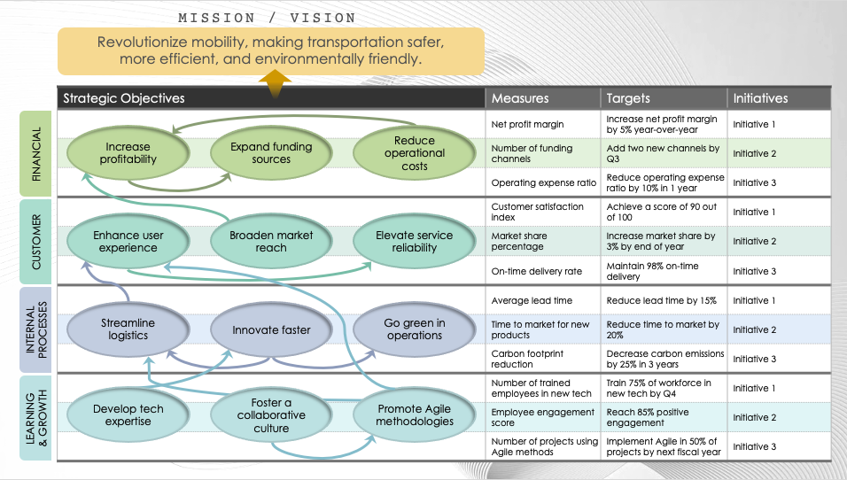
PowerPoint Strategy Map Template
This strategy map template is ideal for outlining corporate strategy in a visually engaging format. The template demonstrates how individual objectives across various business domains are interconnected. Use this template in strategy sessions, board meetings, and workshops to convey how tactical initiatives contribute to the overall mission and vision.
Strategy Map

Slide 2

MISSION / VISION
Revolutionize mobility, making transportation safer,
more efficient, and environmentally friendly.
Strategy Map
Strategic Objectives | Measures | Targets | Initiatives
 | Net profit margin | Increase net profit margin by 5% year-over-year | Initiative 1
 | Number of funding channels | Add two new channels by Q3 | Initiative 2
 | Operating expense ratio | Reduce operating expense ratio by 10% in 1 year | Initiative 3
 | Customer satisfaction index | Achieve a score of 90 out of 100 | Initiative 1
 | Market share percentage | Increase market share by 3% by end of year | Initiative 2
 | On-time delivery rate | Maintain 98% on-time delivery | Initiative 3
 | Average lead time | Reduce lead time by 15% | Initiative 1
 | Time to market for new products | Reduce time to market by 20% | Initiative 2
 | Carbon footprint reduction | Decrease carbon emissions by 25% in 3 years | Initiative 3
 | Number of trained employees in new tech | Train 75% of workforce in new tech by Q4 | Initiative 1
 | Employee engagement score | Reach 85% positive engagement | Initiative 2
 | Number of projects using Agile methods | Implement Agile in 50% of projects by next fiscal year | Initiative 3
Increase profitability
Expand funding sources
Reduce operational costs
FINANCIAL
Enhance user experience
Broaden market reach
Elevate service reliability
CUSTOMER
Streamline logistics
Innovate faster
Go green in operations
INTERNAL PROCESSES
Develop tech expertise
Foster a collaborative culture
Promote Agile methodologies
LEARNING
& GROWTH

Slide 3
MISSION / VISION
Text
Strategy Map
Strategic Objectives | Measures | Targets | Initiatives
FINANCIAL
CUSTOMER
INTERNAL PROCESSES
LEARNING
& GROWTH

Slide 4
DISCLAIMER Any articles, templates, or information provided by Smartsheet on the website are for reference only. While we strive to keep the information up to date and correct, we make no representations or warranties of any kind, express or implied, about the completeness, accuracy, reliability, suitability, or availability with respect to the website or the information, articles, templates, or related graphics contained on the website. Any reliance you place on such information is therefore strictly at your own risk.

