Slide 1


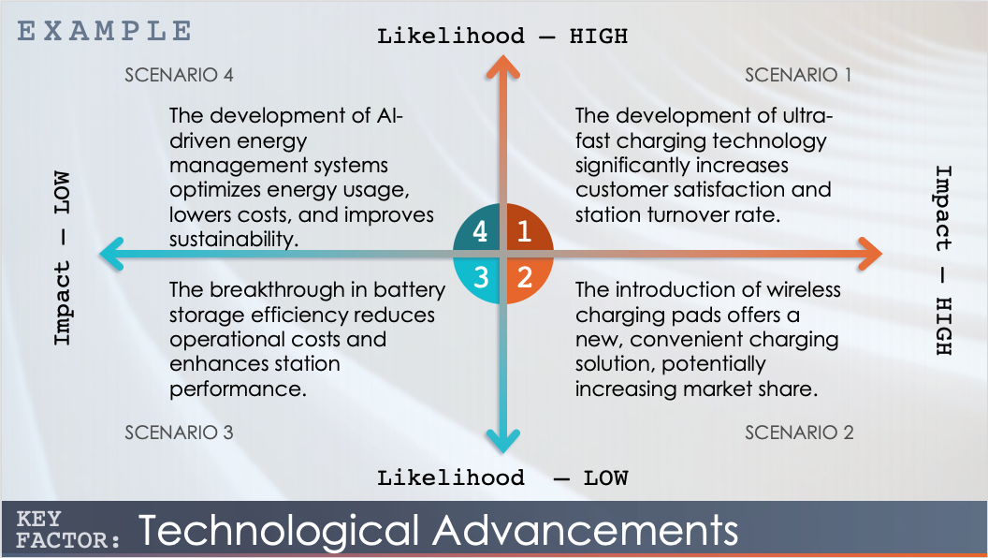
Example Scenario Analysis Axis Template
When to Use This Template: Turn to this scenario analysis axis template when you need a visual tool to compare and contrast different scenarios. With or without sample data, the template is particularly useful for strategic planners and project managers who need to present options to stakeholders and evaluate them based on factors such as risk and reward.
Notable Template Features: This template stands out for its two-dimensional axis system, which enables users to plot scenarios intuitively. It allows you to compare different outcomes based on key variables, enhancing the clarity of strategic discussions. Its straightforward visual design facilitates deeper understanding and more informed decision-making in complex project environments.

Slide 2
EXAMPLE
Likelihood – HIGH
SCENARIO 4
SCENARIO 1
The development of AI-driven energy management systems optimizes energy usage, lowers costs, and improves sustainability.
The development of ultra-fast charging technology significantly increases customer satisfaction and station turnover rate.
4
1
Impact – LOW
Impact – HIGH
3
2
The breakthrough in battery storage efficiency reduces operational costs and enhances station performance.
The introduction of wireless charging pads offers a new, convenient charging solution, potentially increasing market share.
SCENARIO 3
SCENARIO 2
Likelihood – LOW
KEY
Technological Advancements
FACTOR:

Slide 3
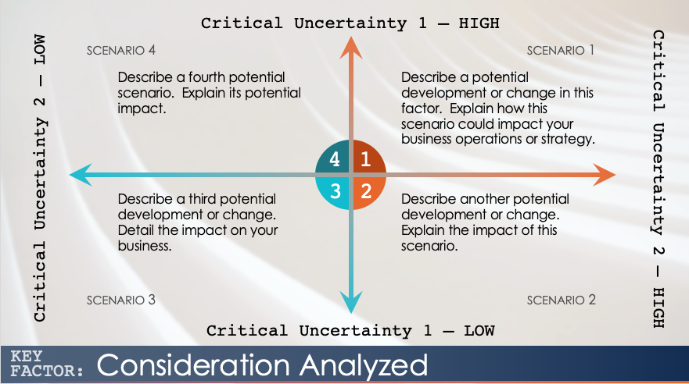
Scenario Analysis Axis Template Instructions
For each factor, consider the most relevant and significant scenarios that could occur, and analyze their potential impacts on your business. This exercise helps in strategic planning, risk management, and decision-making, allowing you to prepare for various possible future developments.

Slide 4
Critical Uncertainty 1 – HIGH
SCENARIO 4
SCENARIO 1
Describe a fourth potential scenario. Explain its potential impact.
Describe a potential development or change in this factor. Explain how this scenario could impact your business operations or strategy.
4
1
Critical Uncertainty 2 – LOW
Critical Uncertainty 2 – HIGH
3
2
Describe a third potential development or change. Detail the impact on your business.
Describe another potential development or change. Explain the impact of this scenario.
SCENARIO 3
SCENARIO 2
Critical Uncertainty 1 – LOW
KEY
Consideration Analyzed
FACTOR:

Slide 5
DISCLAIMER Any articles, templates, or information provided by Smartsheet on the website are for reference only. While we strive to keep the information up to date and correct, we make no representations or warranties of any kind, express or implied, about the completeness, accuracy, reliability, suitability, or availability with respect to the website or the information, articles, templates, or related graphics contained on the website. Any reliance you place on such information is therefore strictly at your own risk.

