Slide 1
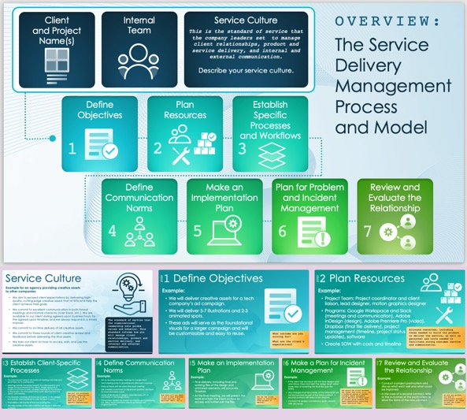
Service Delivery Management Plan Template
Use this free template to guide your SDM process. It includes fields for each essential step of your plan. It also includes space to document the service culture, ensuring that your plan embodies your organization’s values. Available with or without sample data, the template will facilitate your SDM planning process.

Slide 2
Client and Project Name(s)
Internal Team
Service Culture
This is the standard of service that the company leaders set to manage client relationships, product and service delivery, and internal and external communication.
Describe your service culture.
OVERVIEW:
The Service Delivery Management Process
and Model
Define Objectives
Plan Resources
Establish Specific Processes and Workflows
1
2
3
Define Communication Norms
Make an Implementation Plan
Plan for Problem and Incident Management
Review and Evaluate the Relationship
4
5
6
7

Slide 3
Service Culture
Text
The standard of service that the organizational leadership sets guides values and behavior. This standard informs how you will manage client relationships, product and service delivery, and internal and external communication.

Slide 4
1
Define Objectives
STEP
Text
What outcome are you solving for?
What are the client’s expectations?

Slide 5
2
Plan Resources
STEP
Text
Allocate resources, including those needed to build the product or deliver the service, as well as personnel and tools needed to facilitate strong customer service and communication.

Slide 6
3
Establish Client-Specific Processes
STEP
Text
How will you coordinate meetings, communication, and delivery of the product or service to meet this client’s specific expectations?

Slide 7
4
Define Communication Norms
STEP
Text
How often will you check in and on what platforms (video meetings, chat services, email, etc.)?

Slide 8
5
Make an Implementation Plan
STEP
Text
How can the client expect to receive the final product or service?

Slide 9
6
Make a Plan for Incident Management
STEP
Text
How should the client document any issues that arise (e.g., via a ticketing system or another incident report management tool)? Who will be their point of contact going forward? Are there expectations concerning issue resolution time?

Slide 10
7
Review and Evaluate the Relationship
STEP
Text
As with any project, you need to continuously monitor performance. So, check in with the client regularly.

Slide 11
DISCLAIMER Any articles, templates, or information provided by Smartsheet on the website are for reference only. While we strive to keep the information up to date and correct, we make no representations or warranties of any kind, express or implied, about the completeness, accuracy, reliability, suitability, or availability with respect to the website or the information, articles, templates, or related graphics contained on the website. Any reliance you place on such information is therefore strictly at your own risk.

