Slide 1
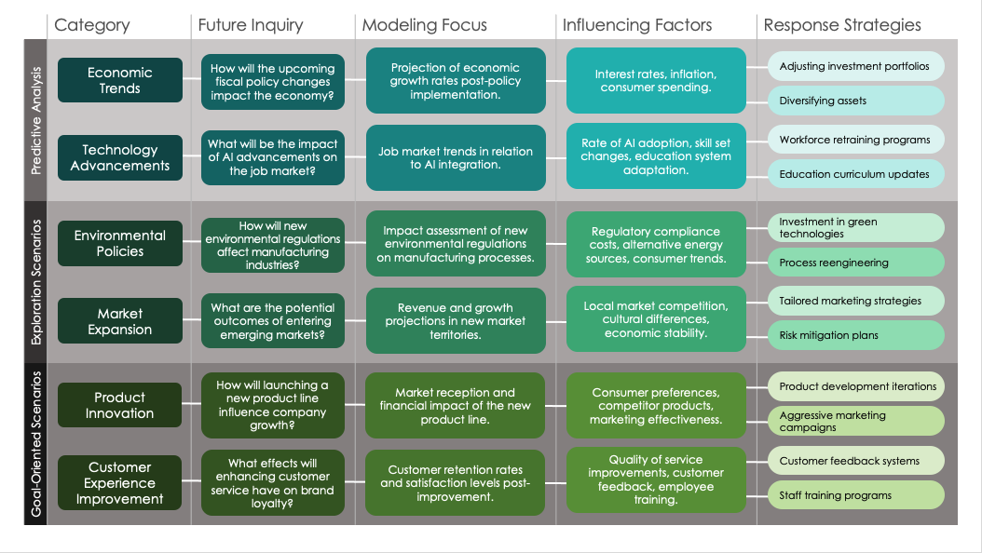
Simple Scenario Analysis Presentation Template – Example
When to Use This Template: Opt for this simple scenario analysis presentation template when you need to communicate straightforward scenario analyses to your team or stakeholders. With or without sample data, the template is particularly useful for team leaders and small business owners who must present basic scenario outcomes clearly during meetings or strategy sessions.
Notable Template Features: This template offers a streamlined format perfect for presentations. Key features include intuitive slide layouts for outlining scenarios and their impacts, along with visual aids to enhance understanding. The template is designed to convey scenario analysis effectively without overwhelming your audience.

Slide 2
 | Category | Future Inquiry | Modeling Focus | Influencing Factors | Response Strategies
Predictive Analysis
Exploration Scenarios
Goal-Oriented Scenarios
Economic
Trends
How will the upcoming fiscal policy changes impact the economy?
Projection of economic growth rates post-policy implementation.
Interest rates, inflation, consumer spending.
Adjusting investment portfolios
Diversifying assets
What will be the impact of AI advancements on the job market?
Job market trends in relation to AI integration.
Rate of AI adoption, skill set changes, education system adaptation.
Workforce retraining programs
Technology Advancements
Education curriculum updates
Environmental Policies
How will new environmental regulations affect manufacturing industries?
Impact assessment of new environmental regulations on manufacturing processes.
Regulatory compliance costs, alternative energy sources, consumer trends.
Investment in green technologies
Process reengineering
What are the potential outcomes of entering emerging markets?
Revenue and growth projections in new market territories.
Local market competition, cultural differences, economic stability.
Tailored marketing strategies
Market
Expansion
Risk mitigation plans
Product Innovation
How will launching a new product line influence company growth?
Market reception and financial impact of the new product line.
Consumer preferences, competitor products, marketing effectiveness.
Product development iterations
Aggressive marketing campaigns
Customer Experience Improvement
What effects will enhancing customer service have on brand loyalty?
Customer retention rates and satisfaction levels post-improvement.
Quality of service improvements, customer feedback, employee training.
Customer feedback systems
Staff training programs
EXAMPLE

Slide 3
 | Category | Future Inquiry | Modeling Focus | Influencing Factors | Response Strategies
Predictive Analysis
Exploration Scenarios
Goal-Oriented Scenarios

Slide 4
DISCLAIMER Any articles, templates, or information provided by Smartsheet on the website are for reference only. While we strive to keep the information up to date and correct, we make no representations or warranties of any kind, express or implied, about the completeness, accuracy, reliability, suitability, or availability with respect to the website or the information, articles, templates, or related graphics contained on the website. Any reliance you place on such information is therefore strictly at your own risk.

