Slide 1

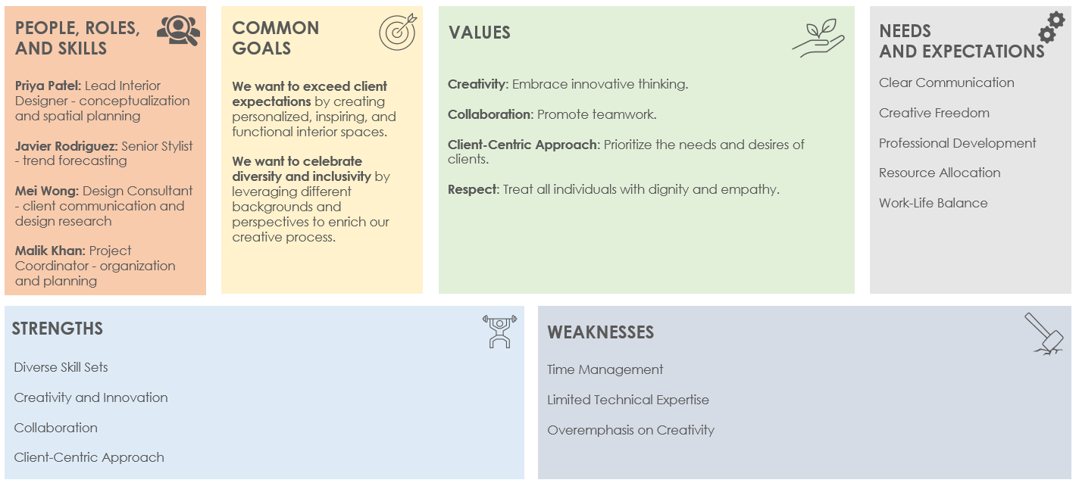
TEAM CHARTER CANVAS TEMPLATE EXAMPLE

Slide 2






TEAM CHARTER CANVAS TEMPLATE EXAMPLE
TEAM NAME: Innovation Home Collective
DATE: MM/DD/YY
PEOPLE, ROLES,
AND SKILLS
COMMON
GOALS
VALUES
NEEDS
AND EXPECTATIONS
Priya Patel: Lead Interior Designer - conceptualization and spatial planning
Javier Rodriguez: Senior Stylist - trend forecasting
Mei Wong: Design Consultant - client communication and design research
Malik Khan: Project Coordinator - organization and planning
We want to exceed client expectations by creating personalized, inspiring, and functional interior spaces.
We want to celebrate diversity and inclusivity by leveraging different backgrounds and perspectives to enrich our creative process.
Creativity: Embrace innovative thinking.
Collaboration: Promote teamwork.
Client-Centric Approach: Prioritize the needs and desires of clients.
Respect: Treat all individuals with dignity and empathy.
Clear Communication
Creative Freedom
Professional Development
Resource Allocation
Work-Life Balance
STRENGTHS
WEAKNESSES
Diverse Skill Sets
Creativity and Innovation
Collaboration
Client-Centric Approach
Time Management
Limited Technical Expertise
Overemphasis on Creativity

Slide 3
DISCLAIMER Any articles, templates, or information provided by Smartsheet on the website are for reference only. While we strive to keep the information up to date and correct, we make no representations or warranties of any kind, express or implied, about the completeness, accuracy, reliability, suitability, or availability with respect to the website or the information, articles, templates, or related graphics contained on the website. Any reliance you place on such information is therefore strictly at your own risk.

