Slide 1

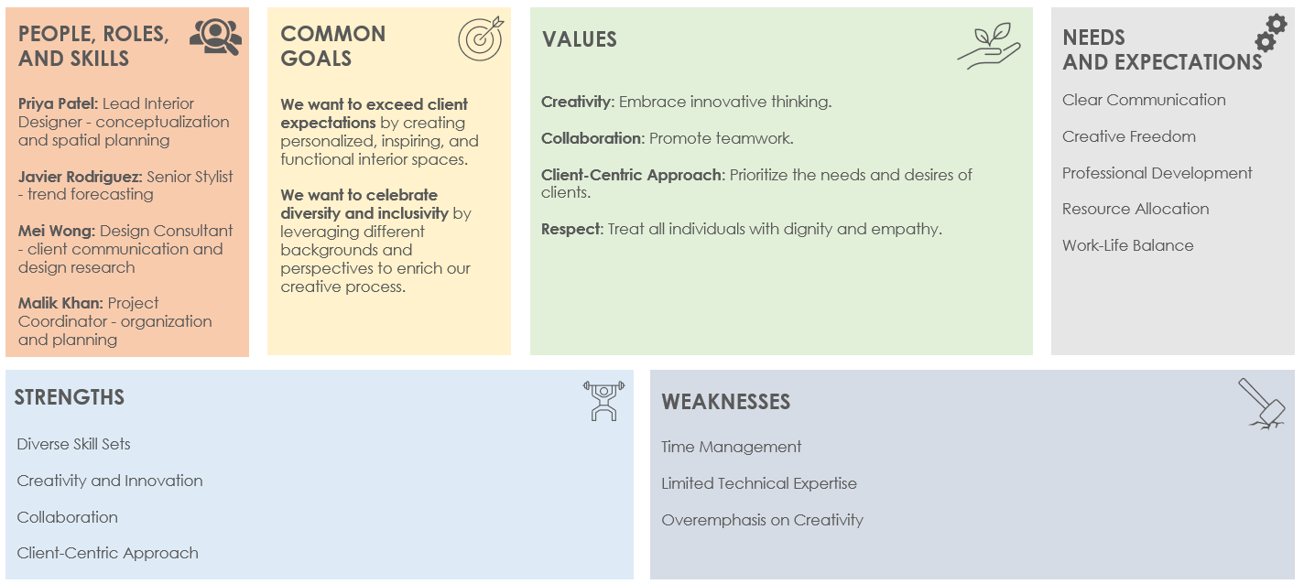
TEAM CHARTER CANVAS TEMPLATE

Slide 2






TEAM CHARTER CANVAS TEMPLATE
TEAM NAME: Name
DATE: MM/DD/YY
PEOPLE, ROLES,
AND SKILLS
COMMON
GOALS
VALUES
NEEDS
AND EXPECTATIONS
Name: Title – skillset
Name: Title - skillset
Define goal with description.
Define goal with description.
Value 1: Description
Value 2: Description
Value 3: Description
Value 4: Description
List
List
List
STRENGTHS
WEAKNESSES
List
List
List
List
List
List

Slide 3
DISCLAIMER Any articles, templates, or information provided by Smartsheet on the website are for reference only. While we strive to keep the information up to date and correct, we make no representations or warranties of any kind, express or implied, about the completeness, accuracy, reliability, suitability, or availability with respect to the website or the information, articles, templates, or related graphics contained on the website. Any reliance you place on such information is therefore strictly at your own risk.

