Slide 1



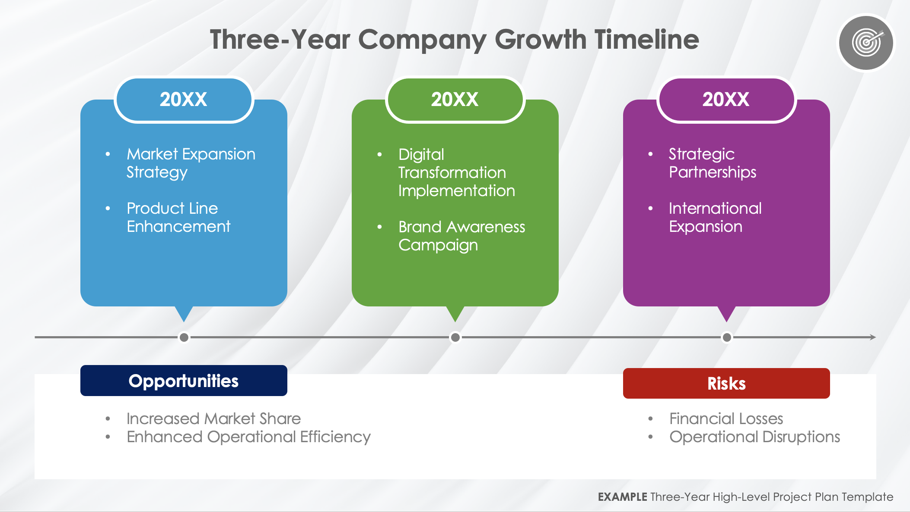
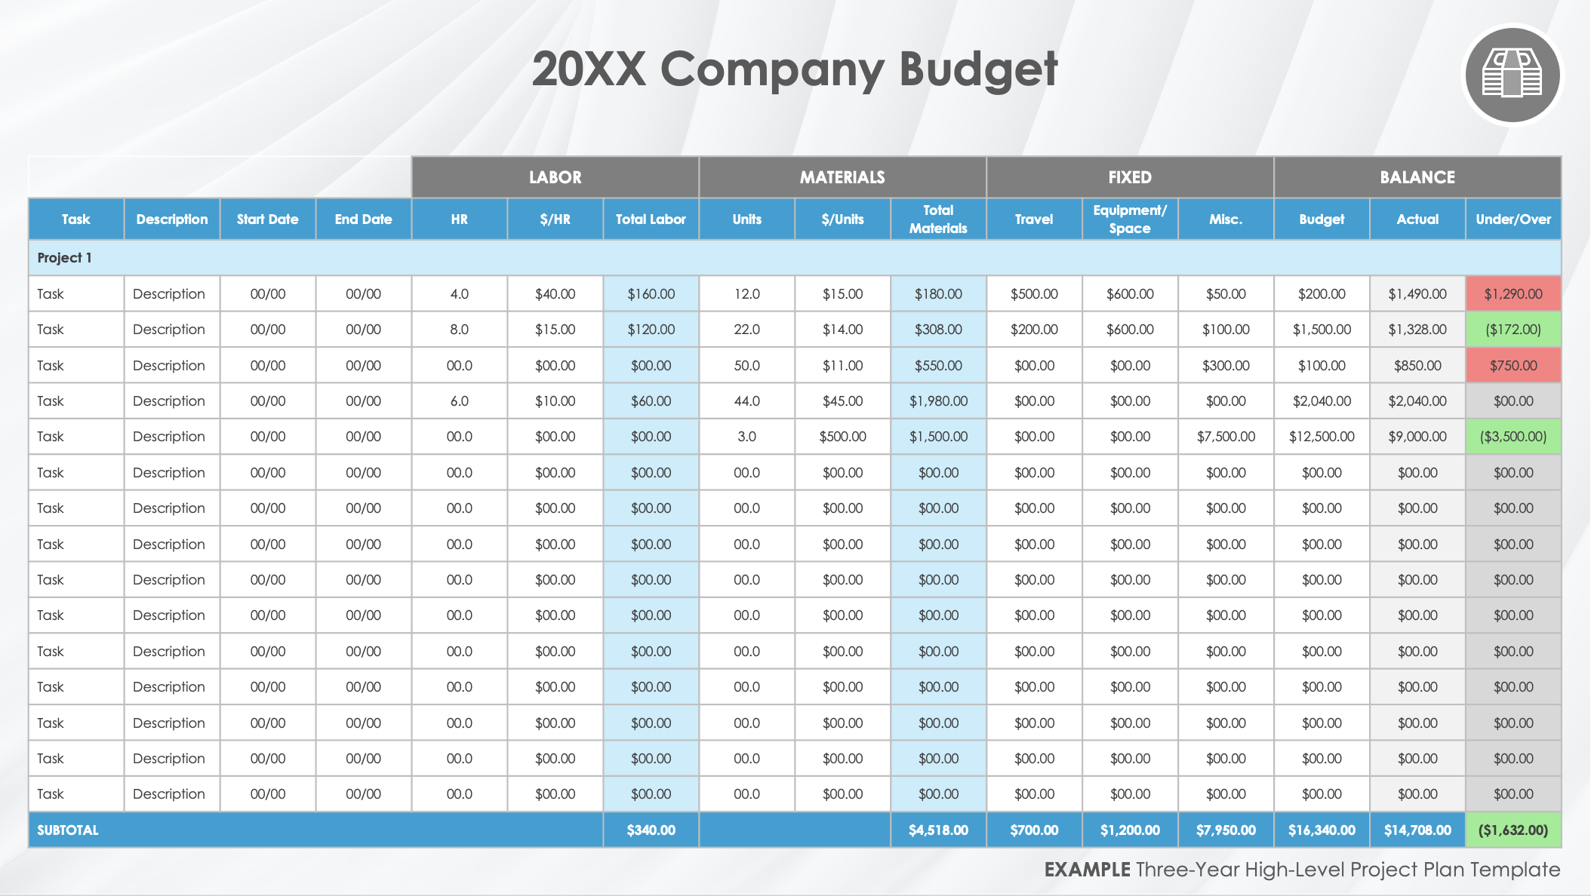
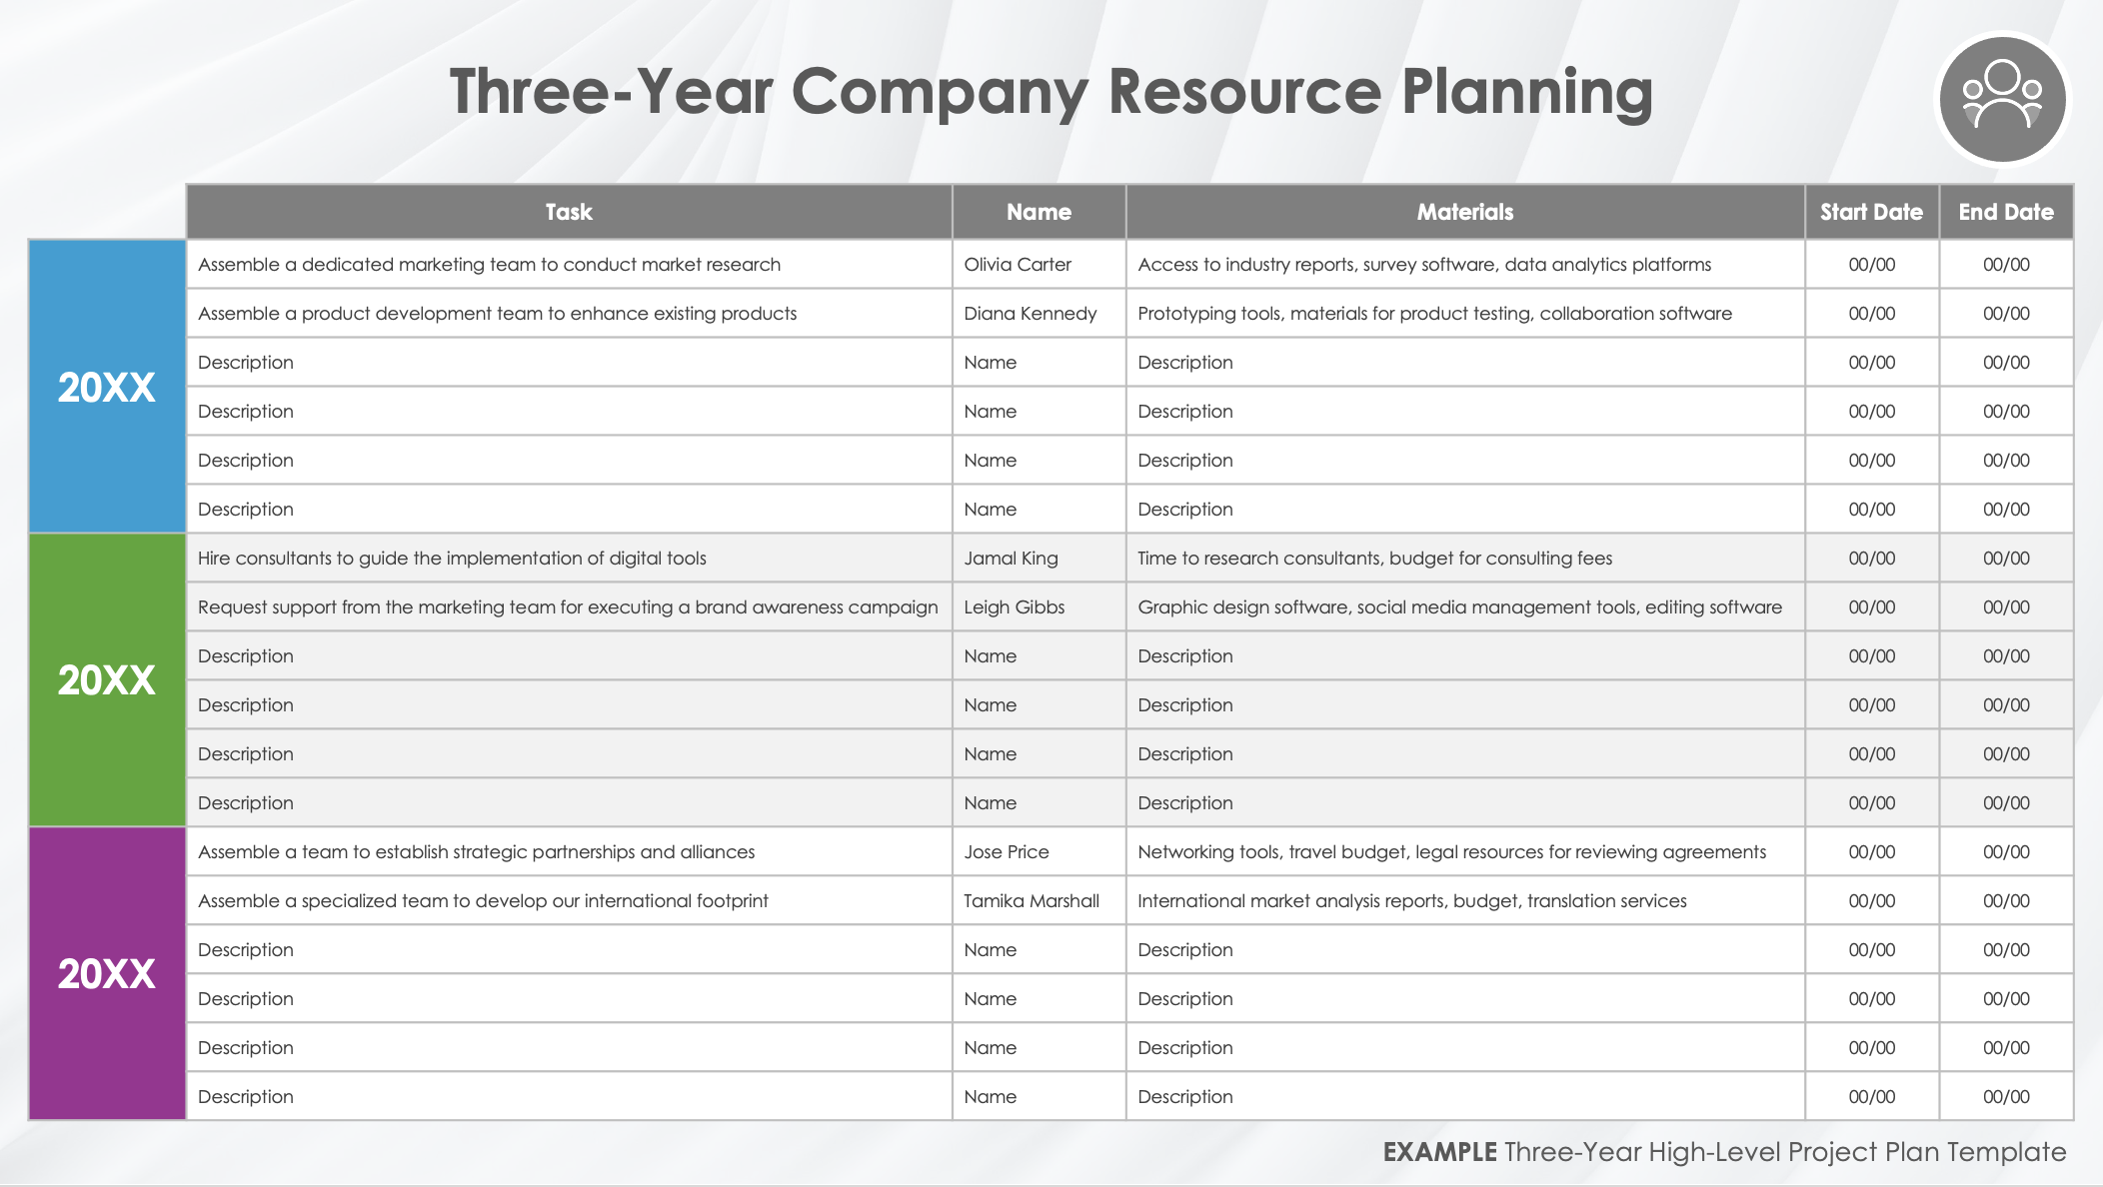
Three-Year High-Level Project Plan Template
When to Use This Template: Project managers can use this multiple-slide template to communicate the basics of a three-year project plan to stakeholders including timeline, budget, and resources.
Notable Template Features: This template provides a slide for you to enter the deliverables for a consecutive three-year project plan. It also includes a slide for budget details and another for resource information, and it comes in both blank and sample data versions that you can customize.

Slide 2

Three-Year Company Growth Timeline
20XX
20XX
20XX
Market Expansion Strategy
Product Line Enhancement
Digital Transformation Implementation
Brand Awareness Campaign
Strategic Partnerships
International Expansion
Opportunities
Risks
Increased Market Share
Enhanced Operational Efficiency
Financial Losses
Operational Disruptions
EXAMPLE Three-Year High-Level Project Plan Template

Slide 3

20XX Company Budget
 |  |  |  | LABOR |  |  | MATERIALS |  |  | FIXED |  |  | BALANCE
Task | Description | Start Date | End Date | HR | $/HR | Total Labor | Units | $/Units | Total Materials | Travel | Equipment/Space | Misc. | Budget | Actual | Under/Over
Project 1
Task | Description | 00/00 | 00/00 | 4.0 | $40.00 | $160.00 | 12.0 | $15.00 | $180.00 | $500.00 | $600.00 | $50.00 | $200.00 | $1,490.00 | $1,290.00
Task | Description | 00/00 | 00/00 | 8.0 | $15.00 | $120.00 | 22.0 | $14.00 | $308.00 | $200.00 | $600.00 | $100.00 | $1,500.00 | $1,328.00 | ($172.00)
Task | Description | 00/00 | 00/00 | 00.0 | $00.00 | $00.00 | 50.0 | $11.00 | $550.00 | $00.00 | $00.00 | $300.00 | $100.00 | $850.00 | $750.00
Task | Description | 00/00 | 00/00 | 6.0 | $10.00 | $60.00 | 44.0 | $45.00 | $1,980.00 | $00.00 | $00.00 | $00.00 | $2,040.00 | $2,040.00 | $00.00
Task | Description | 00/00 | 00/00 | 00.0 | $00.00 | $00.00 | 3.0 | $500.00 | $1,500.00 | $00.00 | $00.00 | $7,500.00 | $12,500.00 | $9,000.00 | ($3,500.00)
Task | Description | 00/00 | 00/00 | 00.0 | $00.00 | $00.00 | 00.0 | $00.00 | $00.00 | $00.00 | $00.00 | $00.00 | $00.00 | $00.00 | $00.00
Task | Description | 00/00 | 00/00 | 00.0 | $00.00 | $00.00 | 00.0 | $00.00 | $00.00 | $00.00 | $00.00 | $00.00 | $00.00 | $00.00 | $00.00
Task | Description | 00/00 | 00/00 | 00.0 | $00.00 | $00.00 | 00.0 | $00.00 | $00.00 | $00.00 | $00.00 | $00.00 | $00.00 | $00.00 | $00.00
Task | Description | 00/00 | 00/00 | 00.0 | $00.00 | $00.00 | 00.0 | $00.00 | $00.00 | $00.00 | $00.00 | $00.00 | $00.00 | $00.00 | $00.00
Task | Description | 00/00 | 00/00 | 00.0 | $00.00 | $00.00 | 00.0 | $00.00 | $00.00 | $00.00 | $00.00 | $00.00 | $00.00 | $00.00 | $00.00
Task | Description | 00/00 | 00/00 | 00.0 | $00.00 | $00.00 | 00.0 | $00.00 | $00.00 | $00.00 | $00.00 | $00.00 | $00.00 | $00.00 | $00.00
Task | Description | 00/00 | 00/00 | 00.0 | $00.00 | $00.00 | 00.0 | $00.00 | $00.00 | $00.00 | $00.00 | $00.00 | $00.00 | $00.00 | $00.00
Task | Description | 00/00 | 00/00 | 00.0 | $00.00 | $00.00 | 00.0 | $00.00 | $00.00 | $00.00 | $00.00 | $00.00 | $00.00 | $00.00 | $00.00
Task | Description | 00/00 | 00/00 | 00.0 | $00.00 | $00.00 | 00.0 | $00.00 | $00.00 | $00.00 | $00.00 | $00.00 | $00.00 | $00.00 | $00.00
Task | Description | 00/00 | 00/00 | 00.0 | $00.00 | $00.00 | 00.0 | $00.00 | $00.00 | $00.00 | $00.00 | $00.00 | $00.00 | $00.00 | $00.00
SUBTOTAL |  |  |  |  |  | $340.00 |  |  | $4,518.00 | $700.00 | $1,200.00 | $7,950.00 | $16,340.00 | $14,708.00 | ($1,632.00)
EXAMPLE Three-Year High-Level Project Plan Template

Slide 4
20XX Company Budget
 |  |  |  | LABOR |  |  | MATERIALS |  |  | FIXED |  |  | BALANCE
Task | Description | Start Date | End Date | HR | $/HR | Total Labor | Units | $/Units | Total Materials | Travel | Equipment/Space | Misc. | Budget | Actual | Under/Over
Project 1
Task | Description | 00/00 | 00/00 | 4.0 | $40.00 | $160.00 | 12.0 | $15.00 | $180.00 | $500.00 | $600.00 | $50.00 | $200.00 | $1,490.00 | $1,290.00
Task | Description | 00/00 | 00/00 | 8.0 | $15.00 | $120.00 | 22.0 | $14.00 | $308.00 | $200.00 | $600.00 | $100.00 | $1,500.00 | $1,328.00 | ($172.00)
Task | Description | 00/00 | 00/00 | 00.0 | $00.00 | $00.00 | 50.0 | $11.00 | $550.00 | $00.00 | $00.00 | $300.00 | $100.00 | $850.00 | $750.00
Task | Description | 00/00 | 00/00 | 6.0 | $10.00 | $60.00 | 44.0 | $45.00 | $1,980.00 | $00.00 | $00.00 | $00.00 | $2,040.00 | $2,040.00 | $00.00
Task | Description | 00/00 | 00/00 | 00.0 | $00.00 | $00.00 | 3.0 | $500.00 | $1,500.00 | $00.00 | $00.00 | $7,500.00 | $12,500.00 | $9,000.00 | ($3,500.00)
Task | Description | 00/00 | 00/00 | 00.0 | $00.00 | $00.00 | 00.0 | $00.00 | $00.00 | $00.00 | $00.00 | $00.00 | $00.00 | $00.00 | $00.00
Task | Description | 00/00 | 00/00 | 00.0 | $00.00 | $00.00 | 00.0 | $00.00 | $00.00 | $00.00 | $00.00 | $00.00 | $00.00 | $00.00 | $00.00
Task | Description | 00/00 | 00/00 | 00.0 | $00.00 | $00.00 | 00.0 | $00.00 | $00.00 | $00.00 | $00.00 | $00.00 | $00.00 | $00.00 | $00.00
Task | Description | 00/00 | 00/00 | 00.0 | $00.00 | $00.00 | 00.0 | $00.00 | $00.00 | $00.00 | $00.00 | $00.00 | $00.00 | $00.00 | $00.00
Task | Description | 00/00 | 00/00 | 00.0 | $00.00 | $00.00 | 00.0 | $00.00 | $00.00 | $00.00 | $00.00 | $00.00 | $00.00 | $00.00 | $00.00
Task | Description | 00/00 | 00/00 | 00.0 | $00.00 | $00.00 | 00.0 | $00.00 | $00.00 | $00.00 | $00.00 | $00.00 | $00.00 | $00.00 | $00.00
Task | Description | 00/00 | 00/00 | 00.0 | $00.00 | $00.00 | 00.0 | $00.00 | $00.00 | $00.00 | $00.00 | $00.00 | $00.00 | $00.00 | $00.00
Task | Description | 00/00 | 00/00 | 00.0 | $00.00 | $00.00 | 00.0 | $00.00 | $00.00 | $00.00 | $00.00 | $00.00 | $00.00 | $00.00 | $00.00
Task | Description | 00/00 | 00/00 | 00.0 | $00.00 | $00.00 | 00.0 | $00.00 | $00.00 | $00.00 | $00.00 | $00.00 | $00.00 | $00.00 | $00.00
Task | Description | 00/00 | 00/00 | 00.0 | $00.00 | $00.00 | 00.0 | $00.00 | $00.00 | $00.00 | $00.00 | $00.00 | $00.00 | $00.00 | $00.00
SUBTOTAL |  |  |  |  |  | $340.00 |  |  | $4,518.00 | $700.00 | $1,200.00 | $7,950.00 | $16,340.00 | $14,708.00 | ($1,632.00)
EXAMPLE Three-Year High-Level Project Plan Template

Slide 5
20XX Company Budget
 |  |  |  | LABOR |  |  | MATERIALS |  |  | FIXED |  |  | BALANCE
Task | Description | Start Date | End Date | HR | $/HR | Total Labor | Units | $/Units | Total Materials | Travel | Equipment/Space | Misc. | Budget | Actual | Under/Over
Project 1
Task | Description | 00/00 | 00/00 | 4.0 | $40.00 | $160.00 | 12.0 | $15.00 | $180.00 | $500.00 | $600.00 | $50.00 | $200.00 | $1,490.00 | $1,290.00
Task | Description | 00/00 | 00/00 | 8.0 | $15.00 | $120.00 | 22.0 | $14.00 | $308.00 | $200.00 | $600.00 | $100.00 | $1,500.00 | $1,328.00 | ($172.00)
Task | Description | 00/00 | 00/00 | 00.0 | $00.00 | $00.00 | 50.0 | $11.00 | $550.00 | $00.00 | $00.00 | $300.00 | $100.00 | $850.00 | $750.00
Task | Description | 00/00 | 00/00 | 6.0 | $10.00 | $60.00 | 44.0 | $45.00 | $1,980.00 | $00.00 | $00.00 | $00.00 | $2,040.00 | $2,040.00 | $00.00
Task | Description | 00/00 | 00/00 | 00.0 | $00.00 | $00.00 | 3.0 | $500.00 | $1,500.00 | $00.00 | $00.00 | $7,500.00 | $12,500.00 | $9,000.00 | ($3,500.00)
Task | Description | 00/00 | 00/00 | 00.0 | $00.00 | $00.00 | 00.0 | $00.00 | $00.00 | $00.00 | $00.00 | $00.00 | $00.00 | $00.00 | $00.00
Task | Description | 00/00 | 00/00 | 00.0 | $00.00 | $00.00 | 00.0 | $00.00 | $00.00 | $00.00 | $00.00 | $00.00 | $00.00 | $00.00 | $00.00
Task | Description | 00/00 | 00/00 | 00.0 | $00.00 | $00.00 | 00.0 | $00.00 | $00.00 | $00.00 | $00.00 | $00.00 | $00.00 | $00.00 | $00.00
Task | Description | 00/00 | 00/00 | 00.0 | $00.00 | $00.00 | 00.0 | $00.00 | $00.00 | $00.00 | $00.00 | $00.00 | $00.00 | $00.00 | $00.00
Task | Description | 00/00 | 00/00 | 00.0 | $00.00 | $00.00 | 00.0 | $00.00 | $00.00 | $00.00 | $00.00 | $00.00 | $00.00 | $00.00 | $00.00
Task | Description | 00/00 | 00/00 | 00.0 | $00.00 | $00.00 | 00.0 | $00.00 | $00.00 | $00.00 | $00.00 | $00.00 | $00.00 | $00.00 | $00.00
Task | Description | 00/00 | 00/00 | 00.0 | $00.00 | $00.00 | 00.0 | $00.00 | $00.00 | $00.00 | $00.00 | $00.00 | $00.00 | $00.00 | $00.00
Task | Description | 00/00 | 00/00 | 00.0 | $00.00 | $00.00 | 00.0 | $00.00 | $00.00 | $00.00 | $00.00 | $00.00 | $00.00 | $00.00 | $00.00
Task | Description | 00/00 | 00/00 | 00.0 | $00.00 | $00.00 | 00.0 | $00.00 | $00.00 | $00.00 | $00.00 | $00.00 | $00.00 | $00.00 | $00.00
Task | Description | 00/00 | 00/00 | 00.0 | $00.00 | $00.00 | 00.0 | $00.00 | $00.00 | $00.00 | $00.00 | $00.00 | $00.00 | $00.00 | $00.00
SUBTOTAL |  |  |  |  |  | $340.00 |  |  | $4,518.00 | $700.00 | $1,200.00 | $7,950.00 | $16,340.00 | $14,708.00 | ($1,632.00)
EXAMPLE Three-Year High-Level Project Plan Template

Slide 6

Three-Year Company Resource Planning
 | Task | Name | Materials | Start Date | End Date
20XX | Assemble a dedicated marketing team to conduct market research | Olivia Carter | Access to industry reports, survey software, data analytics platforms | 00/00 | 00/00
 | Assemble a product development team to enhance existing products | Diana Kennedy | Prototyping tools, materials for product testing, collaboration software | 00/00 | 00/00
 | Description | Name | Description | 00/00 | 00/00
 | Description | Name | Description | 00/00 | 00/00
 | Description | Name | Description | 00/00 | 00/00
 | Description | Name | Description | 00/00 | 00/00
20XX | Hire consultants to guide the implementation of digital tools | Jamal King | Time to research consultants, budget for consulting fees | 00/00 | 00/00
 | Request support from the marketing team for executing a brand awareness campaign | Leigh Gibbs | Graphic design software, social media management tools, editing software | 00/00 | 00/00
 | Description | Name | Description | 00/00 | 00/00
 | Description | Name | Description | 00/00 | 00/00
 | Description | Name | Description | 00/00 | 00/00
 | Description | Name | Description | 00/00 | 00/00
20XX | Assemble a team to establish strategic partnerships and alliances | Jose Price | Networking tools, travel budget, legal resources for reviewing agreements | 00/00 | 00/00
 | Assemble a specialized team to develop our international footprint | Tamika Marshall | International market analysis reports, budget, translation services | 00/00 | 00/00
 | Description | Name | Description | 00/00 | 00/00
 | Description | Name | Description | 00/00 | 00/00
 | Description | Name | Description | 00/00 | 00/00
 | Description | Name | Description | 00/00 | 00/00
EXAMPLE Three-Year High-Level Project Plan Template

Slide 7
Three-Year Company Growth Timeline
20XX
20XX
20XX
Sample text
Sample text
Sample text
Sample text
Sample text
Sample text
Sample text
Sample text
Sample text
Sample text
Sample text
Sample text
Opportunities
Risks
Sample text
Sample text
Sample text
Sample text
Sample text
Sample text
Three-Year High-Level Project Plan Template

Slide 8
20XX Company Budget
 |  |  |  | LABOR |  |  | MATERIALS |  |  | FIXED |  |  | BALANCE
Task | Description | Start Date | End Date | HR | $/HR | Total Labor | Units | $/Units | Total Materials | Travel | Equipment/Space | Misc. | Budget | Actual | Under/Over
Project 1
Task | Description | 00/00 | 00/00 | 00.0 | $00.00 | $00.00 | 00.0 | $00.00 | $00.00 | $00.00 | $00.00 | $00.00 | $00.00 | $00.00 | $00.00
Task | Description | 00/00 | 00/00 | 00.0 | $00.00 | $00.00 | 00.0 | $00.00 | $00.00 | $00.00 | $00.00 | $00.00 | $00.00 | $00.00 | $00.00
Task | Description | 00/00 | 00/00 | 00.0 | $00.00 | $00.00 | 00.0 | $00.00 | $00.00 | $00.00 | $00.00 | $00.00 | $00.00 | $00.00 | $00.00
Task | Description | 00/00 | 00/00 | 00.0 | $00.00 | $00.00 | 00.0 | $00.00 | $00.00 | $00.00 | $00.00 | $00.00 | $00.00 | $00.00 | $00.00
Task | Description | 00/00 | 00/00 | 00.0 | $00.00 | $00.00 | 00.0 | $00.00 | $00.00 | $00.00 | $00.00 | $00.00 | $00.00 | $00.00 | $00.00
Task | Description | 00/00 | 00/00 | 00.0 | $00.00 | $00.00 | 00.0 | $00.00 | $00.00 | $00.00 | $00.00 | $00.00 | $00.00 | $00.00 | $00.00
Task | Description | 00/00 | 00/00 | 00.0 | $00.00 | $00.00 | 00.0 | $00.00 | $00.00 | $00.00 | $00.00 | $00.00 | $00.00 | $00.00 | $00.00
Task | Description | 00/00 | 00/00 | 00.0 | $00.00 | $00.00 | 00.0 | $00.00 | $00.00 | $00.00 | $00.00 | $00.00 | $00.00 | $00.00 | $00.00
Task | Description | 00/00 | 00/00 | 00.0 | $00.00 | $00.00 | 00.0 | $00.00 | $00.00 | $00.00 | $00.00 | $00.00 | $00.00 | $00.00 | $00.00
Task | Description | 00/00 | 00/00 | 00.0 | $00.00 | $00.00 | 00.0 | $00.00 | $00.00 | $00.00 | $00.00 | $00.00 | $00.00 | $00.00 | $00.00
Task | Description | 00/00 | 00/00 | 00.0 | $00.00 | $00.00 | 00.0 | $00.00 | $00.00 | $00.00 | $00.00 | $00.00 | $00.00 | $00.00 | $00.00
Task | Description | 00/00 | 00/00 | 00.0 | $00.00 | $00.00 | 00.0 | $00.00 | $00.00 | $00.00 | $00.00 | $00.00 | $00.00 | $00.00 | $00.00
Task | Description | 00/00 | 00/00 | 00.0 | $00.00 | $00.00 | 00.0 | $00.00 | $00.00 | $00.00 | $00.00 | $00.00 | $00.00 | $00.00 | $00.00
Task | Description | 00/00 | 00/00 | 00.0 | $00.00 | $00.00 | 00.0 | $00.00 | $00.00 | $00.00 | $00.00 | $00.00 | $00.00 | $00.00 | $00.00
Task | Description | 00/00 | 00/00 | 00.0 | $00.00 | $00.00 | 00.0 | $00.00 | $00.00 | $00.00 | $00.00 | $00.00 | $00.00 | $00.00 | $00.00
SUBTOTAL |  |  |  |  |  | $00.00 |  |  | $00.00 | $00.00 | $00.00 | $00.00 | $00.00 | $00.00 | $00.00
Three-Year High-Level Project Plan Template

Slide 9
20XX Company Budget
 |  |  |  | LABOR |  |  | MATERIALS |  |  | FIXED |  |  | BALANCE
Task | Description | Start Date | End Date | HR | $/HR | Total Labor | Units | $/Units | Total Materials | Travel | Equipment/Space | Misc. | Budget | Actual | Under/Over
Project 1
Task | Description | 00/00 | 00/00 | 00.0 | $00.00 | $00.00 | 00.0 | $00.00 | $00.00 | $00.00 | $00.00 | $00.00 | $00.00 | $00.00 | $00.00
Task | Description | 00/00 | 00/00 | 00.0 | $00.00 | $00.00 | 00.0 | $00.00 | $00.00 | $00.00 | $00.00 | $00.00 | $00.00 | $00.00 | $00.00
Task | Description | 00/00 | 00/00 | 00.0 | $00.00 | $00.00 | 00.0 | $00.00 | $00.00 | $00.00 | $00.00 | $00.00 | $00.00 | $00.00 | $00.00
Task | Description | 00/00 | 00/00 | 00.0 | $00.00 | $00.00 | 00.0 | $00.00 | $00.00 | $00.00 | $00.00 | $00.00 | $00.00 | $00.00 | $00.00
Task | Description | 00/00 | 00/00 | 00.0 | $00.00 | $00.00 | 00.0 | $00.00 | $00.00 | $00.00 | $00.00 | $00.00 | $00.00 | $00.00 | $00.00
Task | Description | 00/00 | 00/00 | 00.0 | $00.00 | $00.00 | 00.0 | $00.00 | $00.00 | $00.00 | $00.00 | $00.00 | $00.00 | $00.00 | $00.00
Task | Description | 00/00 | 00/00 | 00.0 | $00.00 | $00.00 | 00.0 | $00.00 | $00.00 | $00.00 | $00.00 | $00.00 | $00.00 | $00.00 | $00.00
Task | Description | 00/00 | 00/00 | 00.0 | $00.00 | $00.00 | 00.0 | $00.00 | $00.00 | $00.00 | $00.00 | $00.00 | $00.00 | $00.00 | $00.00
Task | Description | 00/00 | 00/00 | 00.0 | $00.00 | $00.00 | 00.0 | $00.00 | $00.00 | $00.00 | $00.00 | $00.00 | $00.00 | $00.00 | $00.00
Task | Description | 00/00 | 00/00 | 00.0 | $00.00 | $00.00 | 00.0 | $00.00 | $00.00 | $00.00 | $00.00 | $00.00 | $00.00 | $00.00 | $00.00
Task | Description | 00/00 | 00/00 | 00.0 | $00.00 | $00.00 | 00.0 | $00.00 | $00.00 | $00.00 | $00.00 | $00.00 | $00.00 | $00.00 | $00.00
Task | Description | 00/00 | 00/00 | 00.0 | $00.00 | $00.00 | 00.0 | $00.00 | $00.00 | $00.00 | $00.00 | $00.00 | $00.00 | $00.00 | $00.00
Task | Description | 00/00 | 00/00 | 00.0 | $00.00 | $00.00 | 00.0 | $00.00 | $00.00 | $00.00 | $00.00 | $00.00 | $00.00 | $00.00 | $00.00
Task | Description | 00/00 | 00/00 | 00.0 | $00.00 | $00.00 | 00.0 | $00.00 | $00.00 | $00.00 | $00.00 | $00.00 | $00.00 | $00.00 | $00.00
Task | Description | 00/00 | 00/00 | 00.0 | $00.00 | $00.00 | 00.0 | $00.00 | $00.00 | $00.00 | $00.00 | $00.00 | $00.00 | $00.00 | $00.00
SUBTOTAL |  |  |  |  |  | $00.00 |  |  | $00.00 | $00.00 | $00.00 | $00.00 | $00.00 | $00.00 | $00.00
Three-Year High-Level Project Plan Template

Slide 10
20XX Company Budget
 |  |  |  | LABOR |  |  | MATERIALS |  |  | FIXED |  |  | BALANCE
Task | Description | Start Date | End Date | HR | $/HR | Total Labor | Units | $/Units | Total Materials | Travel | Equipment/Space | Misc. | Budget | Actual | Under/Over
Project 1
Task | Description | 00/00 | 00/00 | 00.0 | $00.00 | $00.00 | 00.0 | $00.00 | $00.00 | $00.00 | $00.00 | $00.00 | $00.00 | $00.00 | $00.00
Task | Description | 00/00 | 00/00 | 00.0 | $00.00 | $00.00 | 00.0 | $00.00 | $00.00 | $00.00 | $00.00 | $00.00 | $00.00 | $00.00 | $00.00
Task | Description | 00/00 | 00/00 | 00.0 | $00.00 | $00.00 | 00.0 | $00.00 | $00.00 | $00.00 | $00.00 | $00.00 | $00.00 | $00.00 | $00.00
Task | Description | 00/00 | 00/00 | 00.0 | $00.00 | $00.00 | 00.0 | $00.00 | $00.00 | $00.00 | $00.00 | $00.00 | $00.00 | $00.00 | $00.00
Task | Description | 00/00 | 00/00 | 00.0 | $00.00 | $00.00 | 00.0 | $00.00 | $00.00 | $00.00 | $00.00 | $00.00 | $00.00 | $00.00 | $00.00
Task | Description | 00/00 | 00/00 | 00.0 | $00.00 | $00.00 | 00.0 | $00.00 | $00.00 | $00.00 | $00.00 | $00.00 | $00.00 | $00.00 | $00.00
Task | Description | 00/00 | 00/00 | 00.0 | $00.00 | $00.00 | 00.0 | $00.00 | $00.00 | $00.00 | $00.00 | $00.00 | $00.00 | $00.00 | $00.00
Task | Description | 00/00 | 00/00 | 00.0 | $00.00 | $00.00 | 00.0 | $00.00 | $00.00 | $00.00 | $00.00 | $00.00 | $00.00 | $00.00 | $00.00
Task | Description | 00/00 | 00/00 | 00.0 | $00.00 | $00.00 | 00.0 | $00.00 | $00.00 | $00.00 | $00.00 | $00.00 | $00.00 | $00.00 | $00.00
Task | Description | 00/00 | 00/00 | 00.0 | $00.00 | $00.00 | 00.0 | $00.00 | $00.00 | $00.00 | $00.00 | $00.00 | $00.00 | $00.00 | $00.00
Task | Description | 00/00 | 00/00 | 00.0 | $00.00 | $00.00 | 00.0 | $00.00 | $00.00 | $00.00 | $00.00 | $00.00 | $00.00 | $00.00 | $00.00
Task | Description | 00/00 | 00/00 | 00.0 | $00.00 | $00.00 | 00.0 | $00.00 | $00.00 | $00.00 | $00.00 | $00.00 | $00.00 | $00.00 | $00.00
Task | Description | 00/00 | 00/00 | 00.0 | $00.00 | $00.00 | 00.0 | $00.00 | $00.00 | $00.00 | $00.00 | $00.00 | $00.00 | $00.00 | $00.00
Task | Description | 00/00 | 00/00 | 00.0 | $00.00 | $00.00 | 00.0 | $00.00 | $00.00 | $00.00 | $00.00 | $00.00 | $00.00 | $00.00 | $00.00
Task | Description | 00/00 | 00/00 | 00.0 | $00.00 | $00.00 | 00.0 | $00.00 | $00.00 | $00.00 | $00.00 | $00.00 | $00.00 | $00.00 | $00.00
SUBTOTAL |  |  |  |  |  | $00.00 |  |  | $00.00 | $00.00 | $00.00 | $00.00 | $00.00 | $00.00 | $00.00
Three-Year High-Level Project Plan Template

Slide 11
Three-Year Company Resource Planning
 | Task | Name | Materials | Start Date | End Date
20XX | Description | Name | Description | 00/00 | 00/00
 | Description | Name | Description | 00/00 | 00/00
 | Description | Name | Description | 00/00 | 00/00
 | Description | Name | Description | 00/00 | 00/00
 | Description | Name | Description | 00/00 | 00/00
 | Description | Name | Description | 00/00 | 00/00
20XX | Description | Name | Description | 00/00 | 00/00
 | Description | Name | Description | 00/00 | 00/00
 | Description | Name | Description | 00/00 | 00/00
 | Description | Name | Description | 00/00 | 00/00
 | Description | Name | Description | 00/00 | 00/00
 | Description | Name | Description | 00/00 | 00/00
20XX | Description | Name | Description | 00/00 | 00/00
 | Description | Name | Description | 00/00 | 00/00
 | Description | Name | Description | 00/00 | 00/00
 | Description | Name | Description | 00/00 | 00/00
 | Description | Name | Description | 00/00 | 00/00
 | Description | Name | Description | 00/00 | 00/00
Three-Year High-Level Project Plan Template

Slide 12
DISCLAIMER Any articles, templates, or information provided by Smartsheet on the website are for reference only. While we strive to keep the information up to date and correct, we make no representations or warranties of any kind, express or implied, about the completeness, accuracy, reliability, suitability, or availability with respect to the website or the information, articles, templates, or related graphics contained on the website. Any reliance you place on such information is therefore strictly at your own risk.

