Slide 1

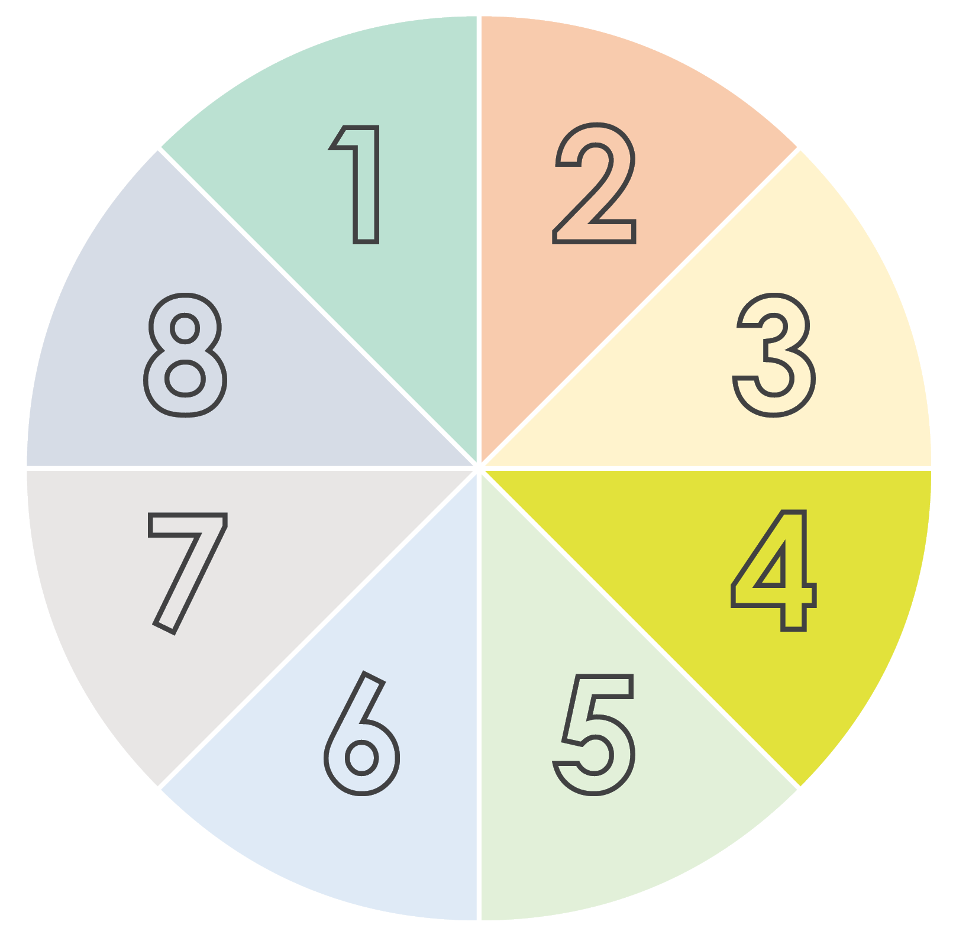
NARRATIVE BUSINESS SCENARIO
PLANNING TEMPLATE

Slide 2
 | 1. Set the Scene |  |  |  |  | 2. Develop Characters
 | Identify Key Focus Areas: Determine your business’s central themes or challenges. Analyze the Current State: Review the present situation of your business and its external environment. Define Objectives: State your goals for scenario planning. |  |  |  |  | List Stakeholders: Identify all relevant stakeholders such as customers, employees, and partners. Assign Roles and Perspectives: Define the roles these stakeholders play and their views on business challenges.
 | 8. Monitor & Adapt |  |  |  |  | 3. Plot Trends
 | Set Indicators: Choose indicators that hint at which scenario is unfolding. Regularly Review and Adjust: Implement a process for ongoing strategy review and adjustments based on new data or changing circumstances. |  |  |  |  | Identify Driving Forces: Spot key trends, uncertainties, and forces that could shape the future. Collect Data and Insights: Gather relevant data and insights on these trends.
 | 7. Plan Implementation |  |  |  |  | 4. Craft Scenarios
 | Schedule and Milestones: Establish a timeline with key milestones for implementing strategies. Allocate Resources: Decide on the necessary resources for each action plan. |  |  |  |  | Write Compelling Narratives: Develop detailed narratives for each scenario, describing future events’ potential unfoldings. Ensure Diverse Outcomes: Cover a broad range of possible futures, from best to worst case..
 |  |  | 6. Formulate Strategies |  | 5. Explore Implications
 |  |  | Develop Strategies: Create strategies that work across various scenarios. Outline Actions: Detail specific steps to seize opportunities or counter risks. |  | Analyze Impacts: Look at how each scenario could affect the business and stakeholders. Spot Opportunities and Risks: Identify potential opportunities and risks in each scenario.

Slide 3
DISCLAIMER Any articles, templates, or information provided by Smartsheet on the website are for reference only. While we strive to keep the information up to date and correct, we make no representations or warranties of any kind, express or implied, about the completeness, accuracy, reliability, suitability, or availability with respect to the website or the information, articles, templates, or related graphics contained on the website. Any reliance you place on such information is therefore strictly at your own risk.

