Slide 1

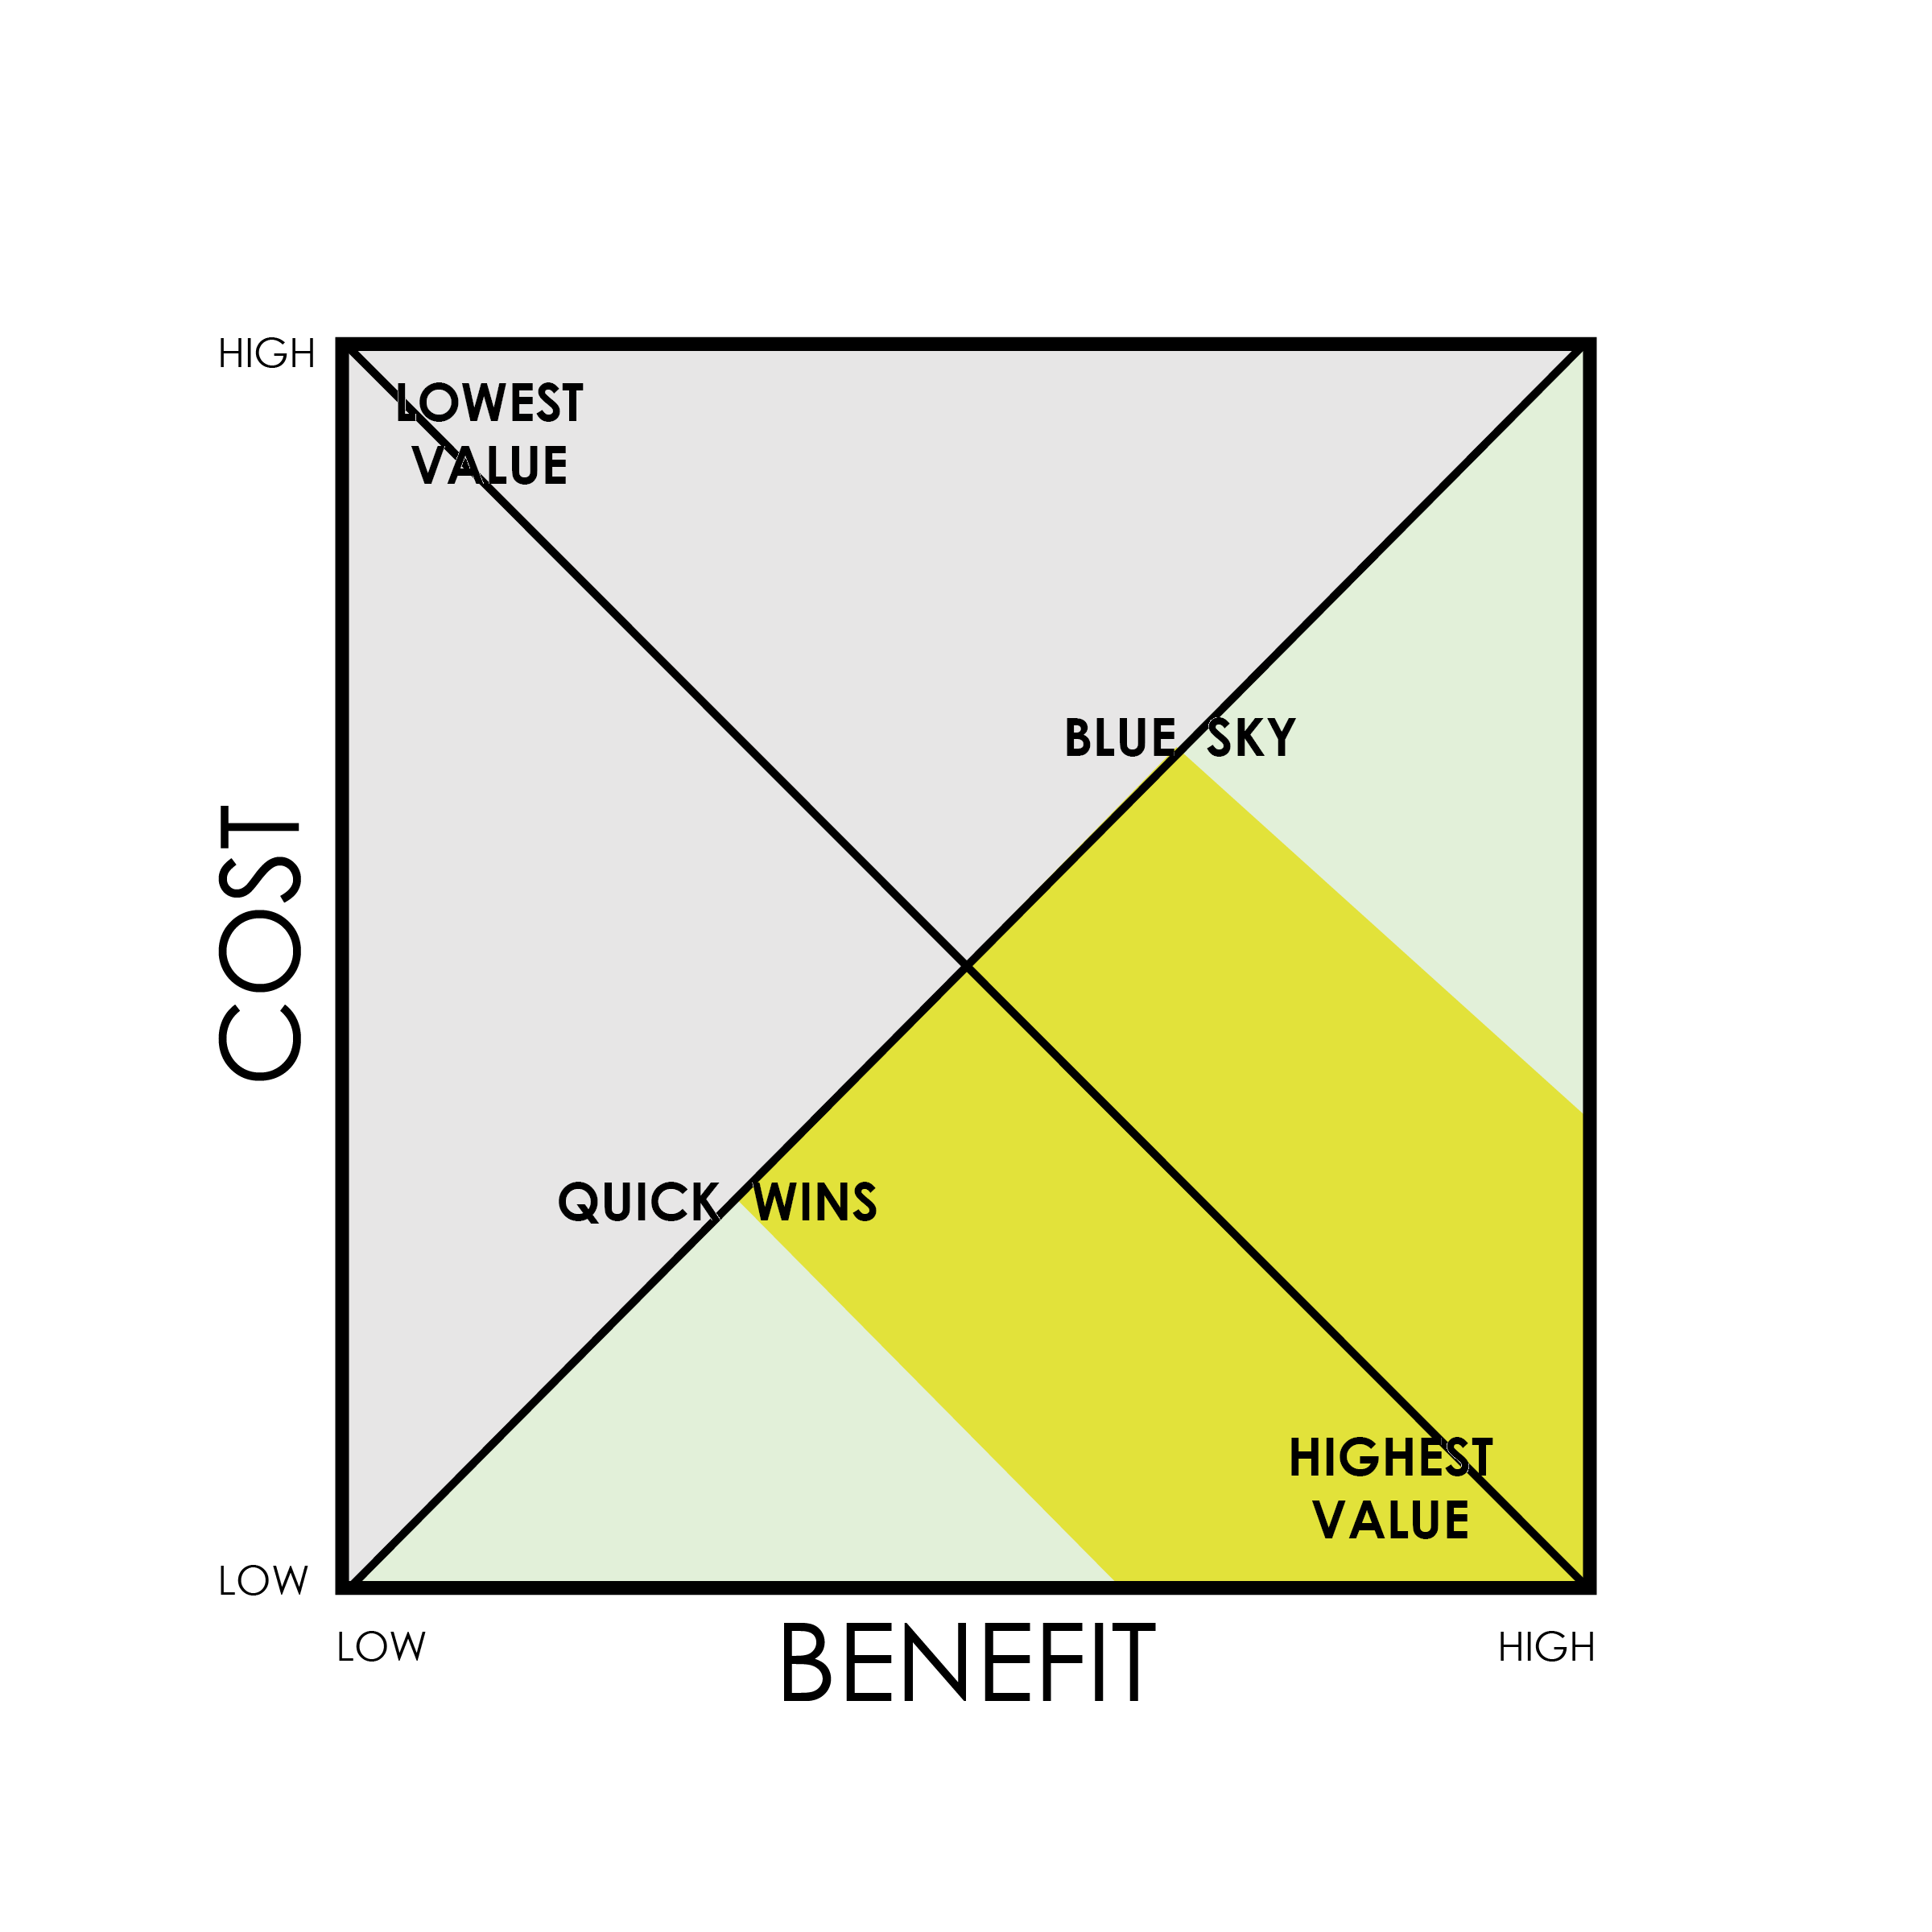
PROBABILITY-BASED
SCENARIO TEMPLATE

Slide 2
5. Technology Disruption
6. Competitor Moves
2. Service Innovation
1. Price Fluctuation
4. Market Entry
7. Consumer Trends
3. Regulatory Impact

Slide 3
 | TEMPLATE LEGEND
 | Lowest Value |  | Quick Wins
 | Scenarios with minimal impact and low probability of occurrence. |  | High probability, low impact scenarios.
 | Purpose: Identify and deprioritize efforts that offer little to no strategic value. |  | Purpose: Focus on easily achievable initiatives that provide immediate benefits.
 | Core Scenarios |  | High Impact
 | Scenarios with moderate probability and impact. |  | Scenarios with significant impact but variable probability.
 | Purpose: Allocate resources to scenarios that are likely to occur and have a moderate impact on the organization. |  | Purpose: Prepare for scenarios that could greatly affect the organization, warranting strategic focus and resource allocation.
 | Highest Value |  | Blue Sky
 | High probability, high impact scenarios. |  | Low probability, high impact scenarios.
 | Purpose: Prioritize these scenarios for planning and investment, as they represent the most valuable opportunities or threats. |  | Purpose: Innovate and plan for long-term, transformative opportunities that could significantly advance the organization if they materialize.

Slide 4
SCENARIOS
1. Price Fluctuation: Variability in pricing strategies or market price changes.
2. Service Innovation: Changes or improvements in service offerings.
3. Regulatory Impact: Effects of new or changing government regulations.
4. Market Entry: Entry into new markets or sectors.
5. Technology Disruptions: Introduction of new technologies that disrupt existing processes or markets.
6. Competitor Moves: Strategic changes or initiatives by competitors.
7. Consumer Trends: Shifts in consumer behavior or preferences.

Slide 5
DISCLAIMER Any articles, templates, or information provided by Smartsheet on the website are for reference only. While we strive to keep the information up to date and correct, we make no representations or warranties of any kind, express or implied, about the completeness, accuracy, reliability, suitability, or availability with respect to the website or the information, articles, templates, or related graphics contained on the website. Any reliance you place on such information is therefore strictly at your own risk.

