Slide 1
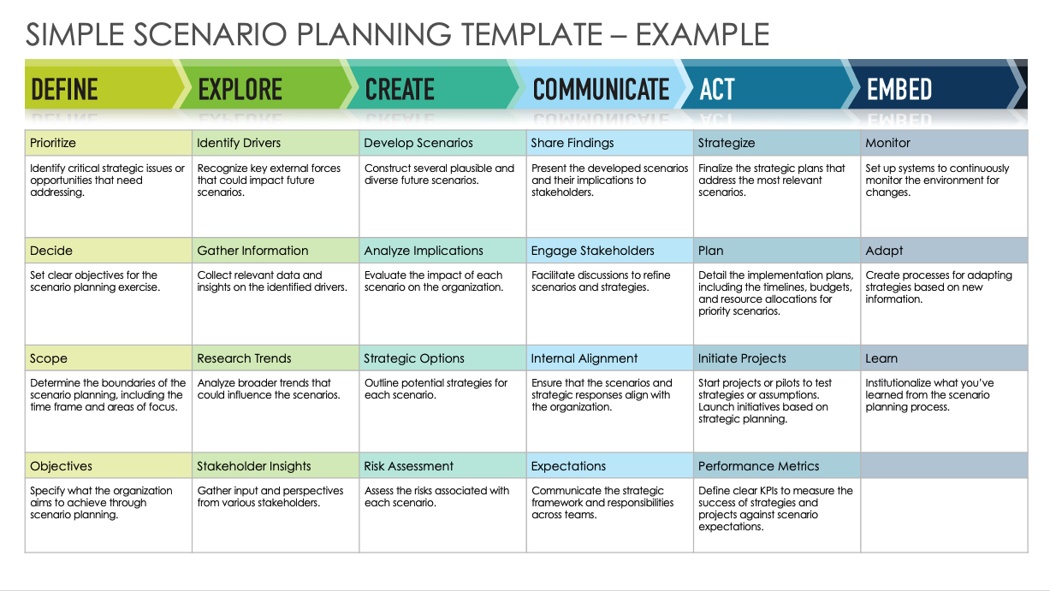
SIMPLE SCENARIO PLANNING TEMPLATE
When to Use This Template:
This template is ideal for business strategists, project managers, and team leaders who are navigating through uncertain markets or planning for future business expansions. It's especially useful when you're looking to explore multiple future outcomes to make informed strategic decisions, ensuring your team or organization can adapt to whatever the future holds.
Notable Template Features:
This simple scenario planning template features a straightforward, user-friendly structure that guides you through identifying, analyzing, and preparing for potential future scenarios. It includes sections for defining objectives, exploring driving forces and trends, creating plausible scenarios, and developing action plans. This setup helps users systematically think through and prepare for various future states, enhancing strategic agility and decision-making capabilities.

Slide 2
SIMPLE SCENARIO PLANNING TEMPLATE
Prioritize | Identify Drivers | Develop Scenarios | Share Findings | Strategize | Monitor
Decide | Gather Information | Analyze Implications | Engage Stakeholders | Plan | Adapt
Scope | Research Trends | Strategic Options | Internal Alignment | Initiate Projects | Learn
Objectives | Stakeholder Insights | Risk Assessment | Expectations | Performance Metrics

Slide 3
SIMPLE SCENARIO PLANNING TEMPLATE – EXAMPLE
Prioritize | Identify Drivers | Develop Scenarios | Share Findings | Strategize | Monitor
Identify critical strategic issues or opportunities that need addressing. | Recognize key external forces that could impact future scenarios. | Construct several plausible and diverse future scenarios. | Present the developed scenarios and their implications to stakeholders. | Finalize the strategic plans that address the most relevant scenarios. | Set up systems to continuously monitor the environment for changes.
Decide | Gather Information | Analyze Implications | Engage Stakeholders | Plan | Adapt
Set clear objectives for the scenario planning exercise. | Collect relevant data and insights on the identified drivers. | Evaluate the impact of each scenario on the organization. | Facilitate discussions to refine scenarios and strategies. | Detail the implementation plans, including the timelines, budgets, and resource allocations for priority scenarios. | Create processes for adapting strategies based on new information.
Scope | Research Trends | Strategic Options | Internal Alignment | Initiate Projects | Learn
Determine the boundaries of the scenario planning, including the time frame and areas of focus. | Analyze broader trends that could influence the scenarios. | Outline potential strategies for each scenario. | Ensure that the scenarios and strategic responses align with the organization. | Start projects or pilots to test strategies or assumptions. Launch initiatives based on strategic planning. | Institutionalize what you’ve learned from the scenario planning process.
Objectives | Stakeholder Insights | Risk Assessment | Expectations | Performance Metrics
Specify what the organization aims to achieve through scenario planning. | Gather input and perspectives from various stakeholders. | Assess the risks associated with each scenario. | Communicate the strategic framework and responsibilities across teams. | Define clear KPIs to measure the success of strategies and projects against scenario expectations.

Slide 4
DISCLAIMER Any articles, templates, or information provided by Smartsheet on the website are for reference only. While we strive to keep the information up to date and correct, we make no representations or warranties of any kind, express or implied, about the completeness, accuracy, reliability, suitability, or availability with respect to the website or the information, articles, templates, or related graphics contained on the website. Any reliance you place on such information is therefore strictly at your own risk.

