Slide 1
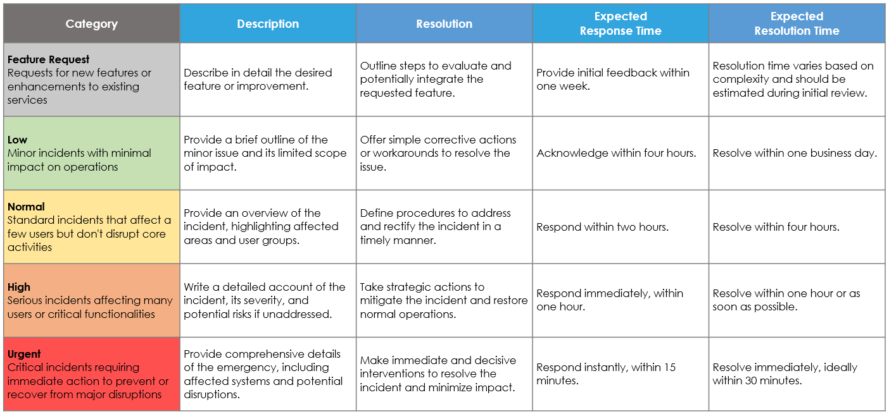
Incident Management Escalation Matrix Template
When To Use This Template: Use this template to systematically manage and escalate incidents based on their severity, ensuring timely and appropriate responses to maintain operational efficiency.
Notable Templates Features: This template features columns for Category, Description, Resolution, Expected Response Time, and Expected Resolution Time. The Category column ranks severity levels from Feature Request to Urgent, providing clear guidelines for prioritizing and handling incidents.

Slide 2
Incident Management Escalation Matrix
Category | Description | Resolution | Expected Response Time | Expected Resolution Time
Feature Request Requests for new features or enhancements to existing services | Describe in detail the desired feature or improvement. | Outline steps to evaluate and potentially integrate the requested feature. | Provide initial feedback within one week. | Resolution time varies based on complexity and should be estimated during initial review.
Low Minor incidents with minimal impact on operations | Provide a brief outline of the minor issue and its limited scope of impact. | Offer simple corrective actions or workarounds to resolve the issue. | Acknowledge within four hours. | Resolve within one business day.
Normal Standard incidents that affect a few users but don't disrupt core activities | Provide an overview of the incident, highlighting affected areas and user groups. | Define procedures to address and rectify the incident in a timely manner. | Respond within two hours. | Resolve within four hours.
High Serious incidents affecting many users or critical functionalities | Write a detailed account of the incident, its severity, and potential risks if unaddressed. | Take strategic actions to mitigate the incident and restore normal operations. | Respond immediately, within one hour. | Resolve within one hour or as soon as possible.
Urgent Critical incidents requiring immediate action to prevent or recover from major disruptions | Provide comprehensive details of the emergency, including affected systems and potential disruptions. | Make immediate and decisive interventions to resolve the incident and minimize impact. | Respond instantly, within 15 minutes. | Resolve immediately, ideally within 30 minutes.

Slide 3
DISCLAIMER Any articles, templates, or information provided by Smartsheet on the website are for reference only. While we strive to keep the information up to date and correct, we make no representations or warranties of any kind, express or implied, about the completeness, accuracy, reliability, suitability, or availability with respect to the website or the information, articles, templates, or related graphics contained on the website. Any reliance you place on such information is therefore strictly at your own risk.

