Slide 1


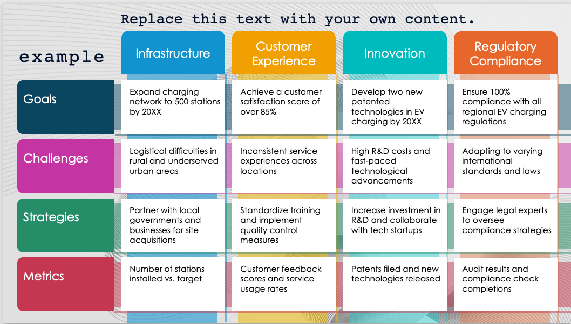
PowerPoint 4x4 Matrix Diagram Template – Example
When to Use This Template: Use this template for in-depth analysis and comprehensive comparison of multiple variables, perfect for strategic planning, performance evaluation, and detailed presentations.
Notable Template Features: This template offers a versatile 4x4 grid layout in PowerPoint, allowing for extensive customization with editable sections, color schemes, and the integration of visual aids to enhance clarity and impact.

Slide 2

Replace this text with your own content.
Infrastructure
Customer Experience
Innovation
Regulatory Compliance
example
Expand charging network to 500 stations by 20XX
Achieve a customer satisfaction score of over 85%
Develop two new patented technologies in EV charging by 20XX
Ensure 100% compliance with all regional EV charging regulations
Goals
Logistical difficulties in rural and underserved urban areas
Inconsistent service experiences across locations
High R&D costs and fast-paced technological advancements
Adapting to varying international standards and laws
Challenges
Partner with local governments and businesses for site acquisitions
Standardize training and implement quality control measures
Increase investment in R&D and collaborate with tech startups
Engage legal experts to oversee compliance strategies
Strategies
Number of stations installed vs. target
Customer feedback scores and service usage rates
Patents filed and new technologies released
Audit results and compliance check completions
Metrics

Slide 3
Replace this text with your own content.
Text
Text
Text
Text
Text
Text
Text
Text
Text
Text
Text
Text
Text
Text
Text
Text
Text
Text
Text
Text
Text
Text
Text
Text

Slide 4
DISCLAIMER Any articles, templates, or information provided by Smartsheet on the website are for reference only. While we strive to keep the information up to date and correct, we make no representations or warranties of any kind, express or implied, about the completeness, accuracy, reliability, suitability, or availability with respect to the website or the information, articles, templates, or related graphics contained on the website. Any reliance you place on such information is therefore strictly at your own risk.

