Slide 1


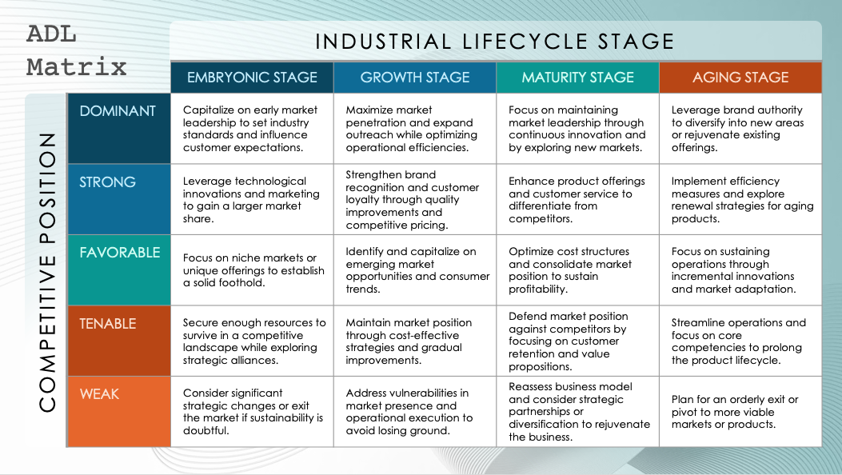
PowerPoint ADL Matrix Template
When to Use This Template: Use this template to analyze and position your business or products within the ADL (Arthur D. Little) matrix. This matrix is designed for strategic planning and will help you assess your competitive positioning based on industry maturity and your competitive position in the market.
Notable Template Features: This PowerPoint template is designed specifically for the ADL matrix and includes customizable sections for analyzing industry maturity and competitive position. This layout allows you to clearly visualize and analyze your strategic position.

Slide 2

ADL Matrix
INDUSTRIAL LIFECYCLE STAGE
 | EMBRYONIC STAGE | GROWTH STAGE | MATURITY STAGE | AGING STAGE
DOMINANT | Capitalize on early market leadership to set industry standards and influence customer expectations. | Maximize market penetration and expand outreach while optimizing operational efficiencies. | Focus on maintaining market leadership through continuous innovation and by exploring new markets. | Leverage brand authority to diversify into new areas or rejuvenate existing offerings.
STRONG | Leverage technological innovations and marketing to gain a larger market share. | Strengthen brand recognition and customer loyalty through quality improvements and competitive pricing. | Enhance product offerings and customer service to differentiate from competitors. | Implement efficiency measures and explore renewal strategies for aging products.
FAVORABLE | Focus on niche markets or unique offerings to establish a solid foothold. | Identify and capitalize on emerging market opportunities and consumer trends. | Optimize cost structures and consolidate market position to sustain profitability. | Focus on sustaining operations through incremental innovations and market adaptation.
TENABLE | Secure enough resources to survive in a competitive landscape while exploring strategic alliances. | Maintain market position through cost-effective strategies and gradual improvements. | Defend market position against competitors by focusing on customer retention and value propositions. | Streamline operations and focus on core competencies to prolong the product lifecycle.
WEAK | Consider significant strategic changes or exit the market if sustainability is doubtful. | Address vulnerabilities in market presence and operational execution to avoid losing ground. | Reassess business model and consider strategic partnerships or diversification to rejuvenate the business. | Plan for an orderly exit or pivot to more viable markets or products.
COMPETITIVE POSITION

Slide 3
ADL Matrix
INDUSTRIAL LIFECYCLE STAGE
 | EMBRYONIC STAGE | GROWTH STAGE | MATURITY STAGE | AGING STAGE
DOMINANT
STRONG
FAVORABLE
TENABLE
WEAK
COMPETITIVE POSITION

Slide 4
DISCLAIMER Any articles, templates, or information provided by Smartsheet on the website are for reference only. While we strive to keep the information up to date and correct, we make no representations or warranties of any kind, express or implied, about the completeness, accuracy, reliability, suitability, or availability with respect to the website or the information, articles, templates, or related graphics contained on the website. Any reliance you place on such information is therefore strictly at your own risk.

