Slide 1

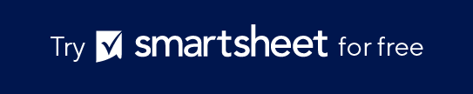
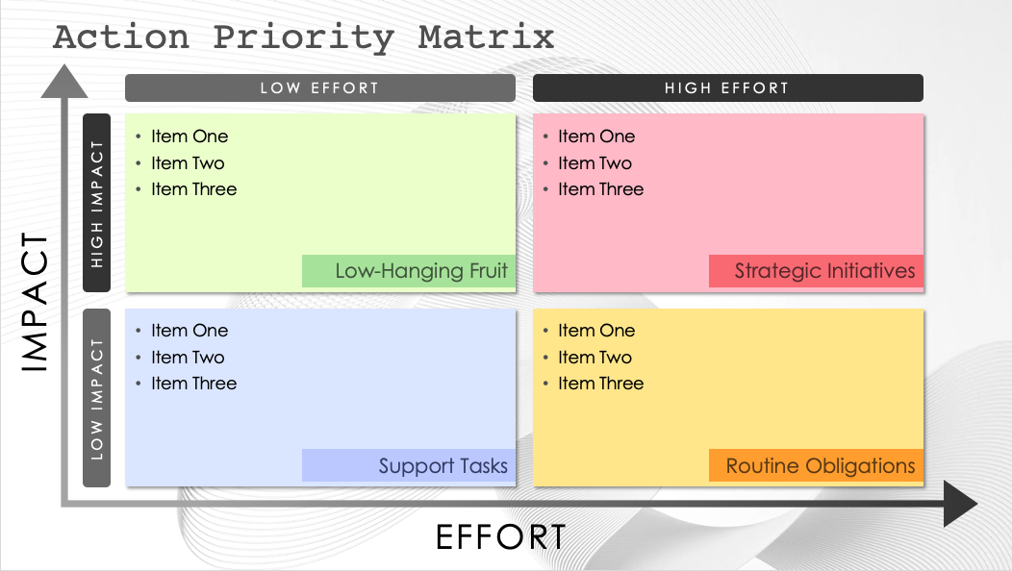
PowerPoint Action Priority Matrix Template
When to Use This Template: Use this template to prioritize and organize actions or tasks in any project management or goal setting situation. This is a simple tool that allows you to assess the project ROI of different actions by weighing the effort and impact of each.
Notable Template Elements: This PowerPoint template is structured as a simple matrix with two axes: Effort and Impact. Place each potential action on the graph, along with the task description, priority level, and deadline. Looking at your tasks in this way will enable clear and effective planning and prioritization.

Slide 2

Action Priority Matrix
LOW EFFORT
HIGH EFFORT
Item One
Item Two
Item Three
Item One
Item Two
Item Three
HIGH IMPACT
Low-Hanging Fruit
Strategic Initiatives
IMPACT
Item One
Item Two
Item Three
Item One
Item Two
Item Three
LOW IMPACT
Support Tasks
Routine Obligations
EFFORT

Slide 3
LOW EFFORT
HIGH EFFORT
Item One
Item Two
Item Three
Item One
Item Two
Item Three
HIGH IMPACT
Low-Hanging Fruit
Strategic Initiatives
IMPACT
Item One
Item Two
Item Three
Item One
Item Two
Item Three
LOW IMPACT
Support Tasks
Routine Obligations
EFFORT

Slide 4
DISCLAIMER Any articles, templates, or information provided by Smartsheet on the website are for reference only. While we strive to keep the information up to date and correct, we make no representations or warranties of any kind, express or implied, about the completeness, accuracy, reliability, suitability, or availability with respect to the website or the information, articles, templates, or related graphics contained on the website. Any reliance you place on such information is therefore strictly at your own risk.

