Slide 1


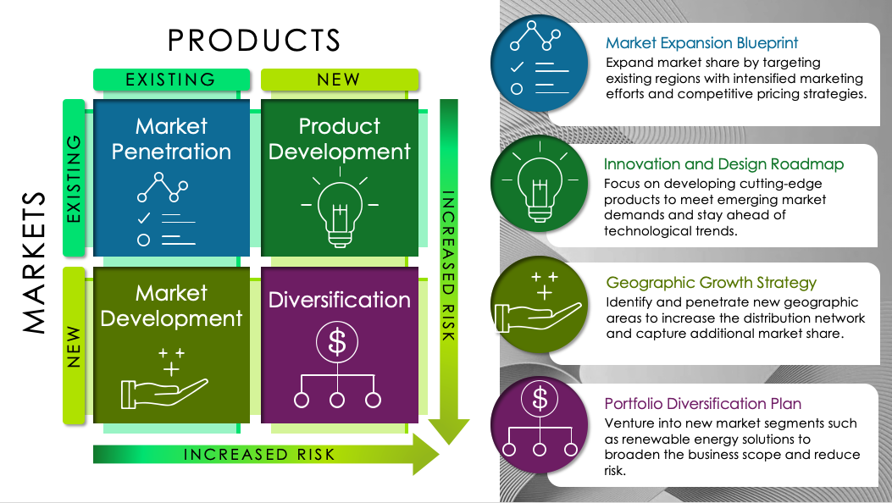
PowerPoint Ansoff Matrix Template
When to Use This Template: Use this template to develop and visualize growth strategies by analyzing market penetration, market development, product development, and diversification options.
Notable Template Characteristics: This template is tailored for the Ansoff Matrix — a strategic tool used to identify and analyze a company's growth opportunities through market penetration, market development, product development, and diversification — with editable sections for each growth strategy quadrant (new and existing markets, new and existing products). This structure will help you in strategic planning presentations.

Slide 2

PRODUCTS
Market Expansion Blueprint
Expand market share by targeting existing regions with intensified marketing efforts and competitive pricing strategies.
EXISTING
NEW
Market Penetration
Product Development
Innovation and Design Roadmap
Focus on developing cutting-edge products to meet emerging market demands and stay ahead of technological trends.
EXISTING
MARKETS
INCREASED RISK
Market Development
Diversification
Geographic Growth Strategy
Identify and penetrate new geographic areas to increase the distribution network and capture additional market share.
NEW
Portfolio Diversification Plan
Venture into new market segments such as renewable energy solutions to broaden the business scope and reduce risk.
INCREASED RISK

Slide 3
PRODUCTS
Text
EXISTING
NEW
Market Penetration
Product Development
Text
EXISTING
MARKETS
INCREASED RISK
Market Development
Diversification
Text
NEW
Text
INCREASED RISK

Slide 4
DISCLAIMER Any articles, templates, or information provided by Smartsheet on the website are for reference only. While we strive to keep the information up to date and correct, we make no representations or warranties of any kind, express or implied, about the completeness, accuracy, reliability, suitability, or availability with respect to the website or the information, articles, templates, or related graphics contained on the website. Any reliance you place on such information is therefore strictly at your own risk.

