Slide 1


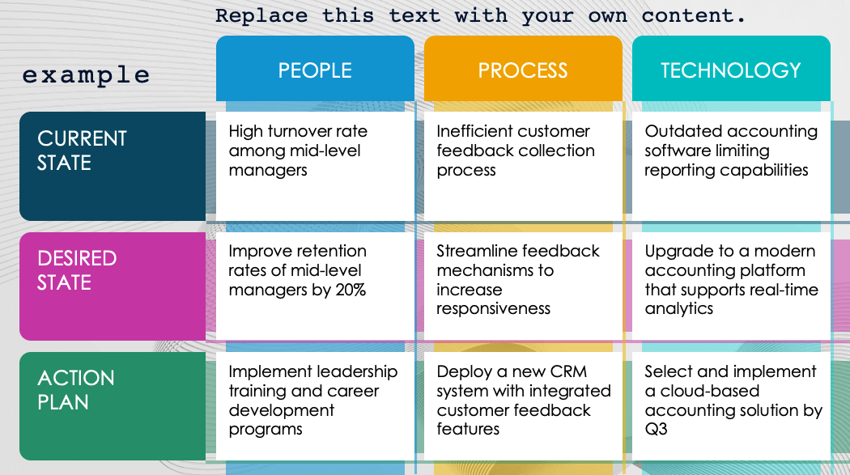
PowerPoint Basic Matrix Toolkit Template (3x3) – Example
When to Use This Template: Use this template to visually organize and compare data, ideas, or strategies in a clear and straightforward 3x3 matrix format, ideal for presentations and decision-making sessions.
Notable Template Features: This template features a clean and customizable 3x3 grid layout in PowerPoint, allowing you to easily insert and adjust text, colors, and graphics to suit your specific needs and enhance your presentations.

Slide 2

PowerPoint Basic Matrix Toolkit Template (3x3) – Example
Replace this text with your own content.
PEOPLE
PROCESS
TECHNOLOGY
example
High turnover rate among mid-level managers
Inefficient customer feedback collection process
Outdated accounting software limiting reporting capabilities
CURRENT STATE
Improve retention rates of mid-level managers by 20%
Streamline feedback mechanisms to increase responsiveness
Upgrade to a modern accounting platform that supports real-time analytics
DESIRED STATE
Implement leadership training and career development programs
Deploy a new CRM system with integrated customer feedback features
Select and implement a cloud-based accounting solution by Q3
ACTION PLAN

Slide 3
Title
TEXT
TEXT
TEXT
Text
Text
Text
TEXT
Text
Text
Text
TEXT
Text
Text
Text
TEXT

Slide 4
DISCLAIMER Any articles, templates, or information provided by Smartsheet on the website are for reference only. While we strive to keep the information up to date and correct, we make no representations or warranties of any kind, express or implied, about the completeness, accuracy, reliability, suitability, or availability with respect to the website or the information, articles, templates, or related graphics contained on the website. Any reliance you place on such information is therefore strictly at your own risk.

