Slide 1


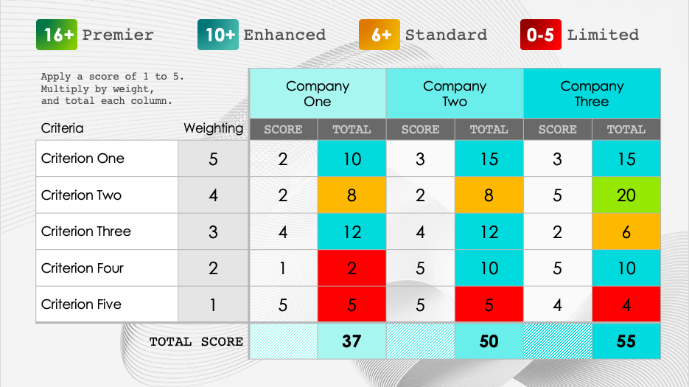
PowerPoint Decision Matrix Template
When to Use This Template: Use this template to systematically evaluate and prioritize different options based on the expected impact of each (minimal, low, moderate, high, or critical). This template will guide you through your decision-making in business, projects, or personal matters by helping you establish your own priorities.
Notable Template Features: This template features a structured layout in PowerPoint with customizable columns to list your different options and criteria. This allows for clear comparison and weighted scoring to facilitate objective decision-making.

Slide 2

Criteria Weighting Definitions
5 | Critical Impact | Assign the highest weight to criteria that are absolutely essential for the decision. These are non-negotiable factors that determine the viability and strategic alignment of the service offering.
4 | High Impact | Criteria with this weight are very important and have a significant impact on the decision. These elements are key to the success of the service and cannot be overlooked.
3 | Moderate Impact | This weight is for criteria that have a noticeable influence on the decision. These factors should be well-considered as they affect the service's effectiveness and customer satisfaction.
2 | Low Impact | Assign this weight to elements that are not crucial but should be considered as they can influence the decision to a small extent. These factors add value but aren't dealbreakers.
1 | Minimal Impact | Use this weight for criteria that have a negligible effect on the overall decision. These are minor considerations that, while worth noting, do not significantly sway the outcome.

Slide 3
16+
Premier Solutions
The highest tier of service offerings, delivering exceptional quality and innovation
10+
Enhanced Options
Offerings that surpass standard expectations with notable benefits and features
6+
Standard Proposals
Services that adequately fulfill basic requirements and norms
0-5
Limited Value
Offerings that do not meet all expected standards, requiring enhancements

Slide 4
16+
Premier
10+
Enhanced
6+
Standard
0-5
Limited
Apply a score of 1 to 5. Multiply by weight, and total each column. |  | Company One |  | Company Two |  | Company Three
Criteria | Weighting | SCORE | TOTAL | SCORE | TOTAL | SCORE | TOTAL
Criterion One | 5 | 2 | 10 | 3 | 15 | 3 | 15
Criterion Two | 4 | 2 | 8 | 2 | 8 | 5 | 20
Criterion Three | 3 | 4 | 12 | 4 | 12 | 2 | 6
Criterion Four | 2 | 1 | 2 | 5 | 10 | 5 | 10
Criterion Five | 1 | 5 | 5 | 5 | 5 | 4 | 4
TOTAL SCORE |  |  | 37 |  | 50 |  | 55

Slide 5
16+
Premier
10+
Enhanced
6+
Standard
0-5
Limited
Apply a score of 1 to 5. Multiply by weight and total each column. |  | Company One |  | Company Two |  | Company Three
Criteria | Weighting | SCORE | TOTAL | SCORE | TOTAL | SCORE | TOTAL
Criterion One | 5
Criterion Two | 4
Criterion Three | 3
Criterion Four | 2
Criterion Five | 1
TOTAL SCORE

Slide 6
DISCLAIMER Any articles, templates, or information provided by Smartsheet on the website are for reference only. While we strive to keep the information up to date and correct, we make no representations or warranties of any kind, express or implied, about the completeness, accuracy, reliability, suitability, or availability with respect to the website or the information, articles, templates, or related graphics contained on the website. Any reliance you place on such information is therefore strictly at your own risk.

