Slide 1


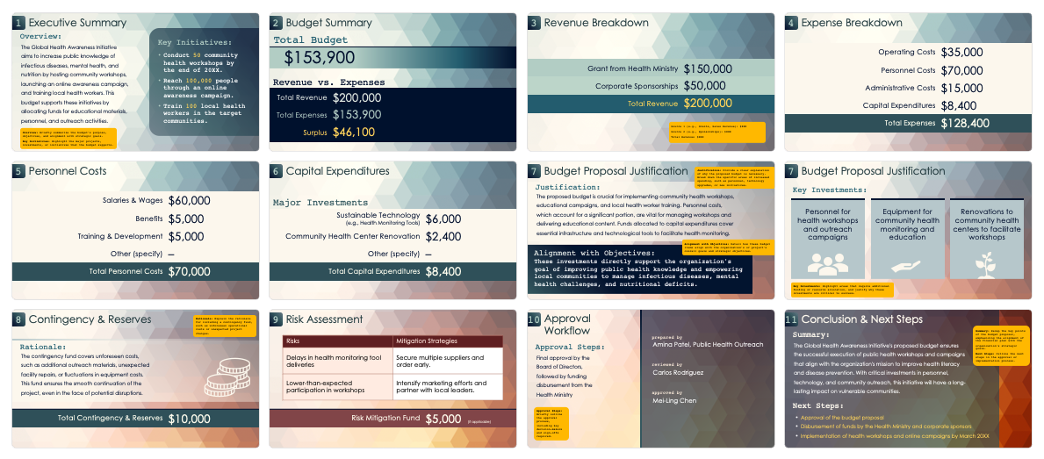
Budget Proposal Presentation Template

Slide 2
Budget Proposal
for / Title
Fiscal Year 20XX
date prepared
prepared by
Month 00, 20XX
Name, Title

Slide 3
1
Executive Summary
7
Budget Proposal Justification
2
Budget Summary
8
Contingency & Reserves
3
Revenue Breakdown
9
Risk Assessment
4
Expense Breakdown
10
Approval Workflow
5
Personnel Costs
11
Conclusion & Next Steps
6
Capital Expenditures

Slide 4
1
Executive Summary
Overview:
Key Initiatives:
Briefly summarize the budget’s purpose, objectives, and alignment with strategic goals.
Highlight the major projects, investments, or initiatives the budget supports.

Slide 5
2
Budget Summary
Total Budget:
$
Revenue vs. Expenses
Total Revenue | $
Total Expenses | $
Surplus | $

Slide 6
3
Revenue Breakdown
Source 1 (e.g., Grants, Sales Revenue) | $
Source 2 (e.g., Sponsorships) | $
Total Revenue | $

Slide 7
4
Expense Breakdown
Operating Costs | $
Personnel Costs | $
Administrative Costs | $
Capital Expenditures | $
Total Expenses | $

Slide 8
5
Personnel Costs
Salaries & Wages | $
Benefits | $
Training & Development | $
Other (specify) | –
Total Personnel Costs | $

Slide 9
6
Capital Expenditures
Major Investments:
Sustainable Technology (e.g., Health Monitoring Tools) | $
Community Health Center Renovation | $
Other (specify) | $
Total Capital Expenditures | $

Slide 10
7
Budget Proposal Justification
Justification:
Provide a clear explanation of why the proposed budget is necessary. Break down the specific areas of increased spending, such as personnel, technology upgrades, or new initiatives.
Alignment with Objectives:
Detail how these budget items align with the organization's or project's overall goals and strategic objectives.

Slide 11


7
Budget Proposal Justification
Key Investments:
Text
Text
Text
Key Investments: Highlight areas that require additional funding or resource allocation and justify why these investments are critical to success.

Slide 12

8
Contingency & Reserves
Rationale:
Explain the rationale for including a contingency fund, such as unforeseen operational costs or unexpected project changes.
Total Contingency & Reserves | $

Slide 13
9
Risk Assessment
Risks | Mitigation Strategies
Risk Mitigation Fund | $ (if applicable)

Slide 14
10
Approval Workflow
prepared by
Approval Steps:
Name, Title
Text
reviewed by
Name
approved by
Name
Approval Steps: Briefly outline the approval process, including key decision-makers and sign-offs required.

Slide 15
11
Conclusion & Next Steps
Summary:
Recap the key points of the budget proposal, emphasizing the alignment of the financial plan with the organization's strategic goals.
Next Steps:
Outline the next steps in the approval or implementation process.
Step 2
Step 3

Slide 16
DISCLAIMER Any articles, templates, or information provided by Smartsheet on the website are for reference only. While we strive to keep the information up to date and correct, we make no representations or warranties of any kind, express or implied, about the completeness, accuracy, reliability, suitability, or availability with respect to the website or the information, articles, templates, or related graphics contained on the website. Any reliance you place on such information is therefore strictly at your own risk.

