Slide 1


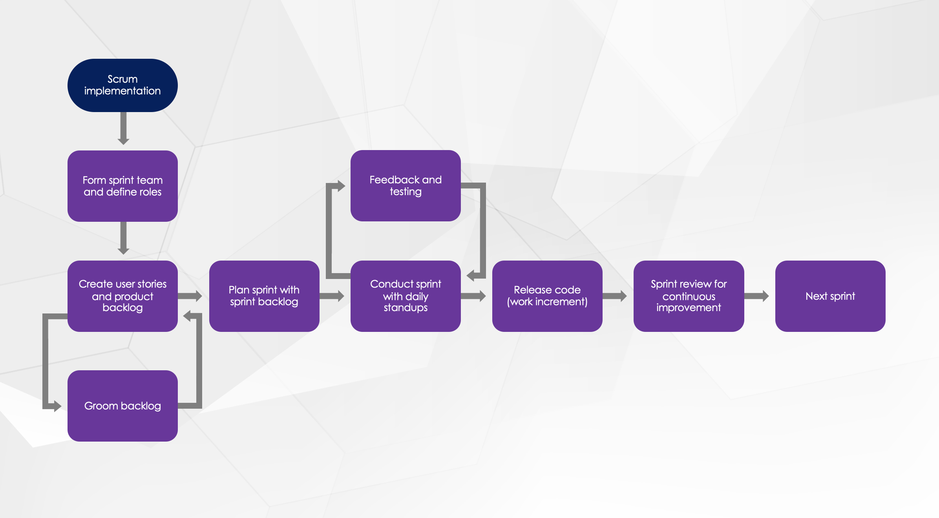
Scrum Workflow Diagram Example and Template

Slide 2
Scrum implementation
Form sprint team and define roles
Feedback and testing
Create user stories and product backlog
Plan sprint with sprint backlog
Conduct sprint with daily standups
Release code (work increment)
Sprint review for continuous improvement
Next sprint
Groom backlog

Slide 3
Sample text
Sample text
Sample text
Sample text
Sample text
Sample text
Sample text
Sample text
Sample text
Sample text

Slide 4
DISCLAIMER Any articles, templates, or information provided by Smartsheet on the website are for reference only. While we strive to keep the information up to date and correct, we make no representations or warranties of any kind, express or implied, about the completeness, accuracy, reliability, suitability, or availability with respect to the website or the information, articles, templates, or related graphics contained on the website. Any reliance you place on such information is therefore strictly at your own risk.

