Slide 1

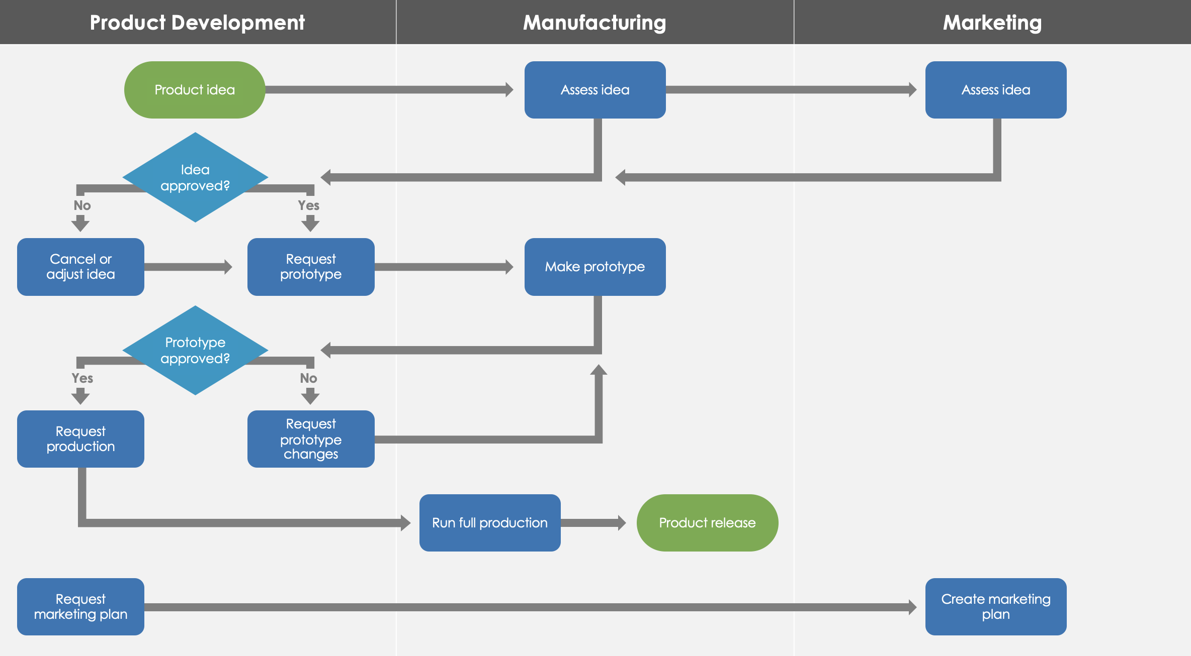
Swimlane Agile Workflow Diagram Example and Template

Slide 2
Product Development | Manufacturing | Marketing
Product idea
Assess idea
Assess idea
Idea approved?
No
Yes
Cancel or
adjust idea
Request prototype
Make prototype
Prototype approved?
Yes
No
Request production
Request prototype changes
Run full production
Product release
Request marketing plan
Create marketing plan

Slide 3
Sample Text | Sample Text | Sample Text
Sample text
Sample text
Sample text
Sample text
No
Yes
Sample text
Sample text
Sample text
Sample text
Yes
No
Sample text
Sample text
Sample text
Sample text
Sample text
Sample text

Slide 4
DISCLAIMER Any articles, templates, or information provided by Smartsheet on the website are for reference only. While we strive to keep the information up to date and correct, we make no representations or warranties of any kind, express or implied, about the completeness, accuracy, reliability, suitability, or availability with respect to the website or the information, articles, templates, or related graphics contained on the website. Any reliance you place on such information is therefore strictly at your own risk.

